Slide 1
coreVWD: What does it mean for you?

Slide 2
Disclosures for: Michelle Lavin
Conflict | Disclosure
Research Support | Takeda
Director, Officer, Employee | None
Shareholder | None
Honoraria | Speaker’s fees from Sobi and Takeda
Advisory Committee | Band Therapeutics
Consultant | Sobi, Takeda, CSL Behring

Slide 3
What is a Core Outcome Set?

Slide 4
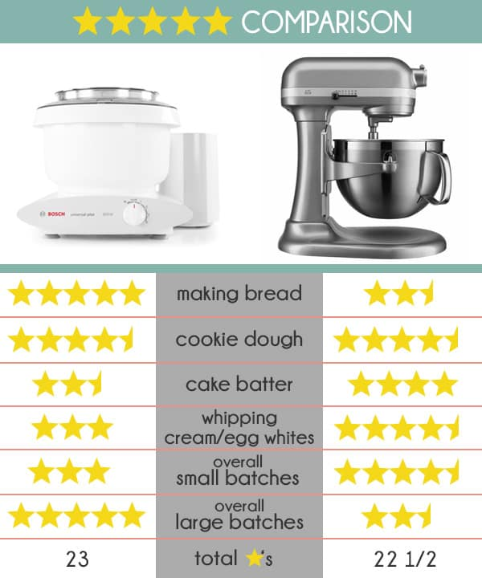

Slide 5
"A core outcome set (COS) is an agreed standardised set of outcomes that should be measured and reported, as a minimum, in all clinical trials in specific areas of health or health care."
https://www.comet-initiative.org/

Slide 6
Why do we need
Core Outcome Sets?

Slide 7
How do we currently measure outcomes in VWD?
Bleeding?

Slide 8
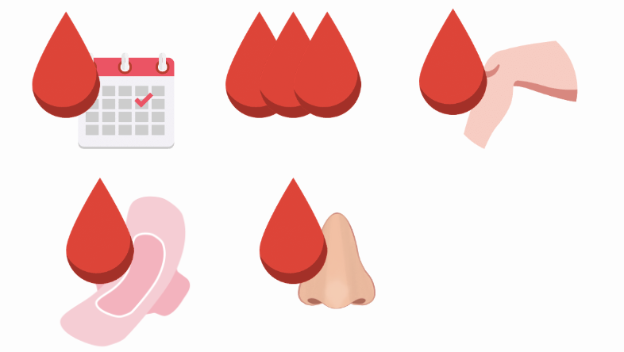
How do we currently measure outcomes in VWD?
Bleeding?
Bleeding Frequency?
Annualised Bleed Rate?

Slide 9
How do we currently measure outcomes in VWD?
Bleeding?
Bleeding Frequency?
Annualised Bleed Rate?
Joint
Bleed Rate?

Slide 10
How do we currently measure outcomes in VWD?
Bleeding?
Bleeding Frequency?
Annualised Bleed Rate?
Joint
Bleed Rate?
Heavy menstrual bleeding ?

Slide 11
How do we currently measure outcomes in VWD?
Bleeding?
Bleeding Frequency?
Annualised Bleed Rate?
Joint
Bleed Rate?
Heavy menstrual bleeding ?
Severity of
bleeding?

Slide 12
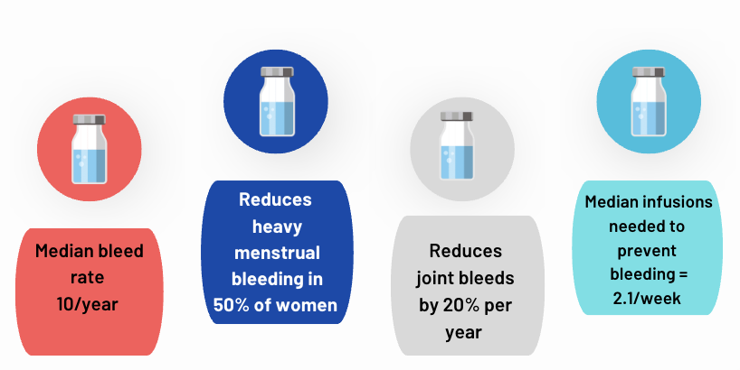
Comparison is challenging if differing outcomes used

Slide 13
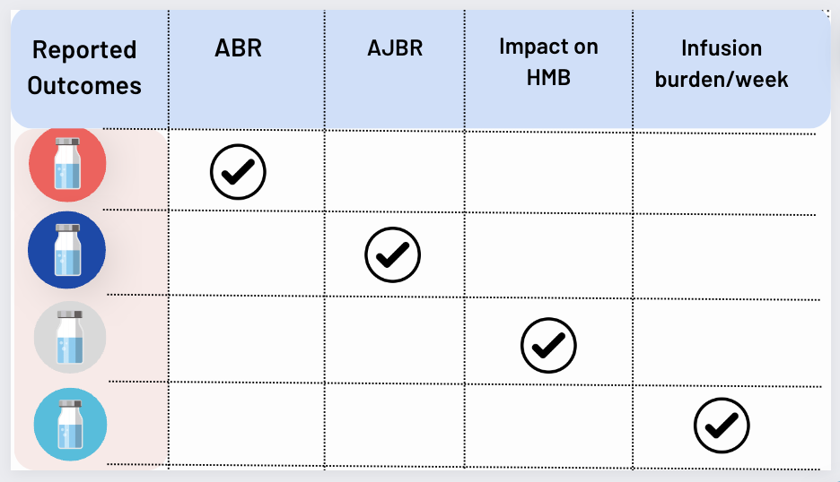
Comparison is challenging if differing outcomes used

Slide 14
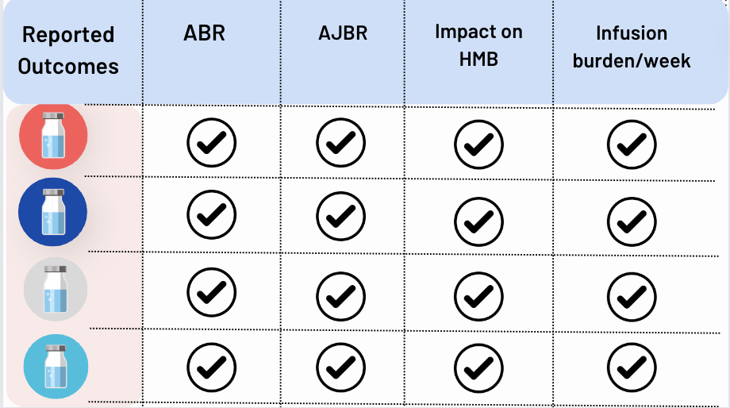
Comparison is challenging if differing outcomes used

Slide 15
Agenda

Slide 16

Agenda
Introduction to coreVWD and why it's important to patients and clinical trial outcomes

Slide 17

Agenda
Introduction to coreVWD and why it's important to patients and clinical trial outcomes
What methods can be used to engage patients as part of a multi-stakeholder group that determines a core outcome set?

Slide 18

Agenda
Introduction to coreVWD and why it's important to patients and clinical trial outcomes
What methods can be used to engage patients as part of a multi-stakeholder group that determines a core outcome set?
What does this ultimately mean for patients and how can NMOs be involved?

Slide 19
Introduction to coreVWD and why it's important to patients and clinical trial outcomes
Mark W. Skinner, JD

Slide 20
Disclosures for: Mark W. Skinner
Conflict | Disclosure - if conflict of interest exists
Research Support | MS institution received funding from Band Therapeutics, Biomarin, Star Therapeutics, Roche and Takeda for the coreVWD project
Director, Officer, Employee | None
Shareholder | None
Honoraria | None
Advisory Committee | None
Consultant | None

Slide 21

Are We Counting What is Relevant?
“Not everything that can be counted counts.
Not everything that counts can be counted.”
Attributed to Albert Einstein
German-born theoretical physicist
1879-1955
Public Domain, https://commons.wikimedia.org/w/index.php?curid=34239518

Slide 22
Core Outcome Sets
An agreed standardised set of outcomes that should be measured and reported, as a minimum, in all clinical research in specific areas of health or health care¹
Among the avoidable barriers to generate robust and sufficient bodies of evidence is ensuring that outcomes selected for clinical trials are harmonized across studies, thereby allowing maximal post-trial appraisal and decisional processes by trusted pooled analyses and indirect comparisons.^{2,3}
¹Definition from the COMET (Core Outcome Measures in Effectiveness Trials) Initiative https://www.comet-initiative.org/ ²Tunis, Clarke, Gorst et al., Improving the relevance and consistency of outcomes in comparative effectiveness research. J Comp Eff Res199 2016; 5: 193–205. ³Iorio A, Skinner MW, Clearfield E, et al. ; for the coreHEM panel. Core outcome set for gene therapy in haemophilia: Results of the coreHEM multistakeholder project. Haemophilia. 2018;00:1–6. https://doi.org/10.1111/hae.13504

Slide 23
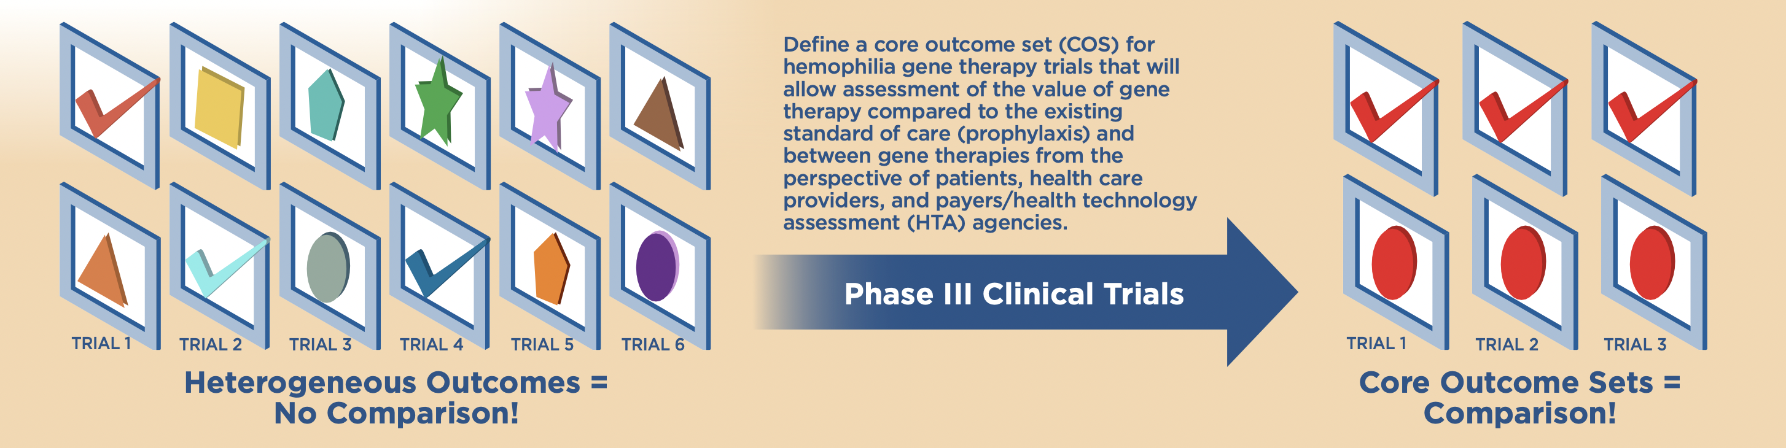
Why do we need core outcome sets?
When clinical trials do not measure the same thing, it is difficult to compare treatment options.
With homogenous outcomes, people can make more informed decisions about treatment options.

Slide 24
How have core outcome sets been used in Bleeding Disorders?
 | Domain | Outcome
coreHEM Core Outcome Set | Physiological/Clinical | Frequency of bleeds
 |  | Factor activity level
 |  | Duration of expression
 | Pain/Discomfort | Chronic pain
 | Resource Use | Utilization of healthcare system (direct costs)
 | Emotional Functioning | Mental health
Iorio A, Skinner MW, Clearfield E, et al. ; for the coreHEM panel. Core outcome set for gene therapy in haemophilia: Results of the coreHEM multistakeholder project. Haemophilia. 2018;00:1–6. https://doi.org/10.1111/hae.13504
Notes:
coreHEM’s generated core outcome set is innovative.
Of the six core outcomes, only frequency of bleeds is a “legacy” outcome, consistently used in past haemophilia trials; its inclusion in the core will enable comparing efficacy and effectiveness with existing treatment and also calculating derived measures such as impact on target joints, a surrogate endpoint for long-term joint function deterioration.
Achieved factor activity level (i.e. restoration of lacking clotting capacity) was the single measure required for approval in the early era of haemophilia treatment, but was later eclipsed by outcomes geared to show the clinical impact of achieving minimal factor activity levels with prophylactic treatment.
With gene therapy achieving near-normal factor activity levels, measurement of factor levels is being actively discussed as and may well re-emerge as a relevant outcome for regulatory approval, in line with the twenty-first-century
Care Act principles.
Duration of expression overcomes any other pharmacokinetic measurements of previous treatments and also speaks to the potential long-term value for investment in providing market access.
Chronic pain and impact on mental health are proposed to capture the entire spectrum of the impact of gene therapy as a definitive cure (as such, with a huge potential for transforming the patient experience) for the functional and social impact of haemophilia.
These outcomes will inform a value-based approach along with measurement of direct healthcare resource use.

Slide 25

An evolution in understanding of key outcomes informed value assessments
2017
2022
Draft Scope
Outcomes of Interest¹
Final Scope
Outcomes of Interest²
Rates of bleeding events
Rates of treated bleeding events
Rates of treated joint bleeding and treated target joint bleeding
Pain
Mortality
Patient-reported quality of life
Harms and burdens of therapy
Patient-reported quality of life
Rates of bleeding events
Rates of treated bleeding events
Rates of treated joint bleeding and treated target joint bleeding
Pain (chronic and acute)
Mental health status
Burden of therapy
Corticosteroid use
Mortality
Adverse events: Thrombosis, liver toxicity, immune response to factor, immune response to gene therapy
Factor level (factor activity level)
Duration of expression of the clotting factor gene
Utilization of healthcare system
coreHEM Outcomes³
1. ICER. Emicizumab for Hemophilia A: Effectiveness and Value. icer.org/wp-content/uploads/2020/10/ICER_Hemophilia_Draft_Scope_091117.pdf. Accessed February 2023;
2. ICER. Gene Therapy for Hemophilia B and An Update on Gene Therapy for Hemophilia A: Effectiveness and Value. icer.org/wp-content/uploads/2022/05/ICER_Hemophilia_Final_Report_12222022.pdf. Accessed February 2023; 3. Iorio A, et al., Haemophilia. 2018;24(4):3167-3172.
25
  Patient-reported quality
  of life
  Rates of bleeding events
  Rates of treated bleeding events
  Rates of treated joint bleeding and treated target joint bleeding
  Pain (chronic and acute)
  Mental health status
  Burden of therapy
  Corticosteroid use
  Mortality
  Adverse events: thrombosis, liver toxicity, immune response to factor, immune response to gene therapy
  Factor level (factor activity level)
  Duration of expression of the clotting factor gene
  Utilization of healthcare system
Notes:
Mention that the community worked to identify and produce data to fill the gaps
(3 ICER Reviews over 5 years)

Slide 26
coreHEM Mental Health Outlook Patient Reported Outcome Tool
Content Validated
Five Domains
Adapted for use in both hemophilia gene therapy and non-gene therapy settings
Available for licensing via NBDF
Stigma
Anxiety
Depression
Life interference
Identity
Misunderstood
Fear
Inadequacy
Restricted/
limited
Role in community
Relating
to others
Future expectations
Feeling alone
Burdened
Sense of self
Ostracized
Dependence
Pride
Regret
Optimism
Clearfield E et al. Poster PCR45, 2022-05 presented at ISPOR 2022, Washington DC, USA.

Slide 27
coreVWD Project Goal
Develop a core outcome set to be included in all pivotal clinical trials and post-approval studies of drug therapies (factor and non-factor) for VWD.
  Expected outcomes demonstrate the value of the therapy
  Access is the goal – measuring the “right” things in clinical trials to bring therapies to the appropriate patients

Slide 28
Useful Across the Lifecycle of a Product
Regulatory decision making
Core outcomes defined, collected and reported in all clinical trials
Health technology appraisal
Increased predictability and consistency when making coverage decisions
Patient-Clinician decision making
Outcomes meaningful to the quality of life and functioning of patients
Market Authorization
Market Access
On-Market Use
Consistent collection and reporting of relevant and well-specified outcomes
Skinner, Clearfield, Iorio, Tunis. Comparing Outcomes Across Clinical Trials: Core Outcome Set for Hemophilia Gene Therapy as a Model for Other Diseases (2017). DIA Global Forum Vol. 9 Issue 5
Notes:
Where are core outcome sets useful? Defining and uniformly implementing a set of outcomes to be included across trials and products has benefits that span the life cycle of a product.
First we think about regulatory-decision making: having a core outcome set helps to ensure that appropriate outcomes are defined, collected, and reported in all clinical trials. It allows for transparency for regulators and the regulatory bodies can know what outcomes to expect.
Then we move on to what we call the post-regulatory decision makers. When thinking about market access and for health technology assessment, a core outcome set allows for increased predictability and consistency to make coverage and reimbursement decisions
And then also we think about for on-market use, in particular, for decision making between patients and their clinicians, especially when we have a novel type of durable treatment such as gene therapy, core outcome sets are a way to ensure there is data about the outcomes are most meaningful to the quality of life and functioning of patients.
And as I said before, a core outcome set is a minimum set of agreed upon outcomes, so it may not include every outcome that a particular stakeholder group finds important, but it should include outcomes that a majority of stakeholder groups agree are important to measure and report.

Slide 29
The Delphi Process
Draft List of Outcomes
Delphi 1
Reduced List of Outcomes
Delphi 2
Online
Reduced List of Outcomes
Consensus Meeting
Online
Delphi 3
Online
In-person
coreVWD Final Core Set
Recommended Outcomes and Adverse Events

Slide 30


Multi-stakeholder by Design
US
payers
clinicians
patients/patient advocates
government
reps
academic researchers
industry sponsor reps
international payers/HTA
methods and epidemiology experts

Slide 31
Multi-stakeholder by Design
US
payers
clinicians
patients/patient advocates
government
reps
academic researchers
industry sponsor reps
international payers/HTA
methods and epidemiology experts

Slide 32
Rating the Outcomes
How you should rate the outcomes:
1-3 | The outcome is not important to include in the core outcome set
4-6 | The outcome is important but not critical to include in the core outcome set
7-9 | The outcome is critical to include in the core outcome set

Slide 33
Consensus Rules
How we decided what to keep and what to eliminate:
High Consensus “Retain” | ≥70% of all voters rated the outcome with a score of 7, 8, or 9
Patient-Important | <70% of all voters rated the outcome 7, 8 or 9, BUT the patient group gave the outcome an average rating of ≥7
Eliminate | <70% of voters rated the outcome 7, 8, or 9, AND the patient group average rating was <7

Slide 34
A Modified “Modified” Delphi?
“Patient-important” outcomes maintained as part of the discussion, regardless of how the other stakeholder groups voted until final round
High Consensus “Retain” | ≥70% of all voters rated the outcome with a score of 7, 8, or 9
Patient-Important | <70% of all voters rated the outcome 7, 8 or 9, BUT the patient group gave the outcome an average rating of ≥7
Eliminate | <70% of voters rated the outcome 7, 8, or 9, AND the patient group average rating was <7

Slide 35
coreVWD Participants
Association française des hémophiles (AFH)
Band Therapeutics
BioMarin
Brigham and Women’s Hospital
Canadian Blood Services
Canadian Hemophilia Society
Coalicion de las Americas (Coalition of the Americas)
Centers for Disease Control and Prevention
Emory University and Children’s Healthcare of Atlanta
Enlightenment Bioconsult, LLC
European Haemophilia Consortium
European Association for Haemophilia and Allied Disorders (EAHAD)
Dutch National Patient Organisation
FDA Center for Drug Evaluation Research (CDER)
FDA Center for Biologics Evaluation and Research (CBER)
Georgetown University
Hemophilia Center of Western PA
Hema-Quebec
Home and Community Care Services, Ontario
Institute for Clinical and Economic Review (ICER)
Kingston Health Sciences Centre
Latvijas Hemofilijas biedrība
Leiden University
Medical College of Wisconsin
National Bleeding Disorders Foundation
Queen’s University
Roche
Star and Electra Therapeutics
St. James Hospital Dublin
Takeda
The Haemophilia Society UK
The Royal Free NHS Foundation Hospital, University College London
Trinity College Dublin
UNC School of Medicine
University of Calgary
University of Pennsylvania
University of Pittsburgh
University of Toronto
Utah Center for Bleeding and Clotting Disorders
World Federation of Hemophilia

Slide 36
What methods can be used to engage patients as part of a multi-stakeholder group that determines a core outcome set?
Elizabeth Clearfield, MHS

Slide 37
Disclosures for: Elizabeth Clearfield
Conflict | Disclosure
Research Support | EC institution received funding from Band Therapeutics, Biomarin, Star Therapeutics, Roche and Takeda for the coreVWD project
Director, Officer, Employee | None
Shareholder | None
Honoraria | None
Advisory Committee | None
Consultant | None

Slide 38
Delphi - Wisdom of Crowds
Diversity of opinions
Independence of opinions
Decentralization and specification of knowledge
Aggregation of private judgements into a collective decision
Trust and fairness within the group
Niederberger M and Spranger J. Delphi Technique in Health Sciences: A Map. Frontiers in Public Health. 2020;8:457.

Slide 39
Patients left behind?
Outcomes not relevant to patients
Recommendations by panels of experts did not include patients

Slide 40
Examples
Duchenne Muscular Dystrophy
6-minute walk test
Stargardt Disease
% change in rate of growth of blind spot
COPD
O₂ saturation
VWD
frequency of bleeding

Slide 41
Examples
Duchenne Muscular Dystrophy
6-minute walk test
Stargardt Disease
% change in rate of growth of blind spot
COPD
O₂ saturation
VWD
frequency of bleeding
Independence

Slide 42
Examples
Duchenne Muscular Dystrophy
6-minute walk test
Stargardt Disease
% change in rate of growth of blind spot
COPD
O₂ saturation
VWD
frequency of bleeding
Independence
Ability to navigate public places

Slide 43
Examples
Duchenne Muscular Dystrophy
6-minute walk test
Stargardt Disease
% change in rate of growth of blind spot
COPD
O₂ saturation
VWD
frequency of bleeding
Independence
Ability to navigate public places
Sleep quality and incontinence

Slide 44
Examples
Duchenne Muscular Dystrophy
6-minute walk test
Stargardt Disease
% change in rate of growth of blind spot
COPD
O₂ saturation
VWD
frequency of bleeding
Independence
Ability to navigate public places
Sleep quality and incontinence
Duration of bleeding/number of bleed days

Slide 45
Patient-Focused Drug Development
Emphasis on the need for patient engagement
Incorporate patient values “upstream,” i.e. before the pivotal trials
“Patient experience data” included in the review materials for FDA¹
  physical and psychosocial impacts of a disease or condition or a related therapy or clinical investigation²
  patient preferences with respect to treatment of the disease or condition²
Gottlieb S. Implementation of the 21st century cures act: progress and the path forward for medical innovation. Testimony of Scott Gottleib, M.D. Commissioner of Food and Drugs Food and Drug Administration Before the Committee on Health, Education, Labor & Pensions, U.S. Senate. 2017.
Patient-Focused Drug Development: Collecting Comprehensive and Representative Input Guidance for Industry, Food and Drug Administration Staff, and Other Stakeholders. U.S. Department of Health and Human Services Food and Drug Administration Center for Drug Evaluation and Research (CDER) Center for Biologics Evaluation and Research (CBER.) June 2020.
Notes:
Intended to provide information about experiences with a disease or condition, including…

Slide 46
Are we getting better?
COMET group performs systematic reviews to identify studies that sought to determine outcomes for clinical trials/develop core outcome sets
Year of Systematic Review | Percent Including Patients or their Representatives
2014¹ | 16%
2019² | 77%
2021³ | 76%
Gargon E, Gurung B, Medley N, Altman D, Blazeby J, Clarke M, Williamson P. Choosing important health outcomes for comparative effectiveness research: a systematic review. Value Health. 2014;17(7):A435.
Gargon E, Gorst SL, Williamson PR. Choosing important health outcomes for comparative effectiveness research: 5th annual update to a systematic review of core outcome sets for research. PLoS One. 2019;14(12):e0225980.
Gargon E, Gorst SL, Matvienko-Sikar K, Williamson PR. Choosing important health outcomes for comparative effectiveness research: 6th annual update to a systematic review of core outcome sets for research. PloS one. 2021;16(1):e0244878.
Notes:
Public: patients, carers, patient support group represenatives
99% included clinical experts

Slide 47
Challenges of patient participation
Survey of COS developers asked about including patients¹
  Difficulty understanding evidence needs for clinical trials
  Tendency to rate “everything” as important
  “Lacked realism” about what is important to measure
1. Gargon E, Williamson PR, Young B. Improving core outcome set development: qualitative interviews with developers provided pointers to inform guidance. J Clin Epidemiol. 2017;86:140–52.
Notes:
What is important for a clinical trial vs what is important for discussion with a clinician

Slide 48
Including patients at each step
When building the Delphi panel, set desired % of overall group in advance
  May consider balancing gender, age, type/severity of condition
Special expertise is not required, but special interest can be helpful when making the time commitment
  Delphi panel
  Advisory board
  Informal interview
Notes:
Avoid sporadic touchpoints and token inclusion
Do not want patients to feel overshadowed by “experts”

Slide 49
coreVWD Participants
 | # | % of Total
Patients/Patient Advocates | 14 | 35%
Clinicians/Researchers | 8 | 21%
Pharma Representatives | 10 | 26%
Government Organizations | 3 | 8%
Health Technology Assessment/Payers | 4 | 10%
Total | 39 | 100

Slide 50
coreVWD Participants
 | # | % of Total
Patients/Patient Advocates | 14 | 35%
Clinicians/Researchers | 8 | 21%
Pharma Representatives | 10 | 26%
Government Organizations | 3 | 8%
Health Technology Assessment/Payers | 4 | 10%
Total | 39 | 100

Slide 51




Partnering with Patient Organizations

Slide 52
Partnering with Patient Organizations
Provide introductions to patients
Input throughout the process
Role in dissemination and acceptance of the COS

Slide 53
Orientation and Training
Key training messaging on how outcome selection can influence
  success or failure of trials (what gets approved)
  access to new therapies as determined by HTA and payer decisions (what gets to market)
  and on clinical decision making (what gets to an individual patient)
Notes:
Topics for training:
epidemiology and natural history of the condition
clinical trial phases/clinical trial design
types of post-regulatory studies
the importance of outcome selection and different types of outcomes
the role of clinical trials in regulatory, market access, and patient care decisions
COS rationale and methods

Slide 54
coreVWD Training Sessions
VWD Background (VWD 101)
Delphi Methods
Outcomes

Slide 55
Delphi Consensus Process
Empower patient stakeholder group to advocate for their priorities
Do not need to defer to clinical experts
Level playing field, no one individual can dominate

Slide 56
Consensus Meeting
Assign tables at to mix stakeholder groups to avoid “us vs them” mentality
Mix of plenary sessions and small group work at tables for patients who may not feel comfortable speaking in the larger group session
Include a trained facilitator/moderator for the day who ensure that patient input is solicited and considered during large group discussions

Slide 57


Understand Why/How a Patient Votes
I don’t know what this is so it must NOT be important.
This sounds technical, so it must be important.

Slide 58
Rating the Outcomes
How you should rate the outcomes:
1-3 | The outcome is not important to include in the core outcome set
4-6 | The outcome is important but not critical to include in the core outcome set
7-9 | The outcome is critical to include in the core outcome set

Slide 59
Reframing the Ratings
How you should rate the outcomes:
1-3 | The outcome is important but I can still make decisions without it
4-6 | The outcome is important but not critical to include in the core outcome set
7-9 | The outcome is critical to include in the core outcome set

Slide 60
Reframing the Ratings
How you should rate the outcomes:
1-3 | The outcome is important but I can still make decisions without it
4-6 | The outcome is important but other outcomes are more important
7-9 | The outcome is critical to include in the core outcome set

Slide 61
Reframing the Ratings
How you should rate the outcomes:
1-3 | The outcome is important but I can still make decisions without it
4-6 | The outcome is important but other outcomes are more important
7-9 | I need this outcome for my decision-making

Slide 62
Patient-Important Criteria
High Consensus “Retain” | ≥70% of all voters rated the outcome with a score of 7, 8, or 9
Patient-Important | <70% of all voters rated the outcome 7, 8 or 9, BUT the patient group gave the outcome an average rating of ≥7
Eliminate | <70% of voters rated the outcome 7, 8, or 9, AND the patient group average rating was <7

Slide 63
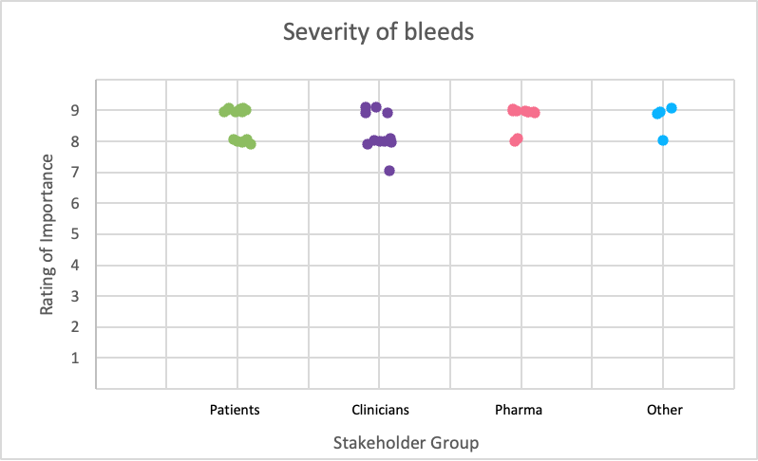
High Consensus in coreVWD
Notes:
From prophy branch round 2

Slide 64
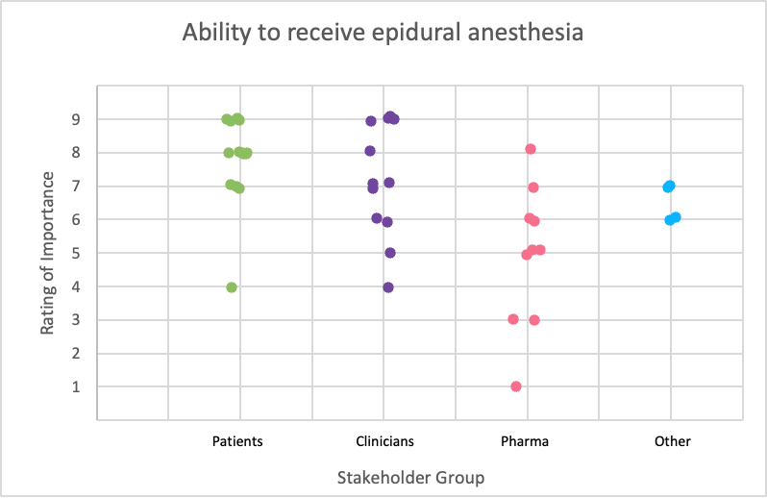
Patient-Important Outcome in coreVWD
Notes:
From prophy branch round 1

Slide 65
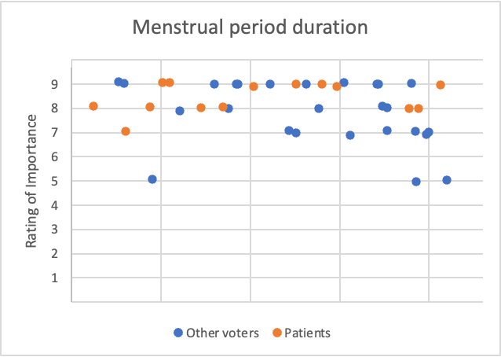
coreVWD Patient-important outcomes
Patient Average: 8.43
Non-Patient Average: 7.81

Slide 66
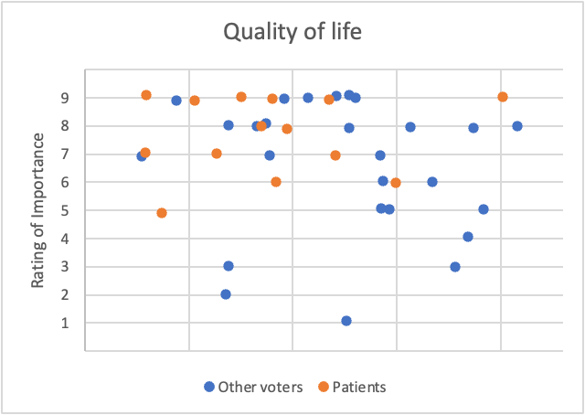
coreVWD Patient-important outcomes
Patient Average: 7.71
Non-Patient Average: 6.58

Slide 67



What does this ultimately mean for patients and how can NMOs be involved?
Paula James, MD, FRCPC

Slide 68
Disclosures for: Paula James
Conflict | Disclosure - if conflict of interest exists
Research Support | Bayer
Director, Officer, Employee
Shareholder
Honoraria
Advisory Committee
Consultant | Band/Guardian Therapeutics, Star/Vega Therapeutics, Roche, BioMarin

Slide 69
Results

Slide 70
67
38
Outcomes
Outcomes
Prophylaxis Treatment
Perioperative Treatment
WGPPM
Candidate List of Outcomes
Delphi Round 1
65 Outcomes
26 Outcomes
Delphi Round 2
Consensus Meeting
40 + Outcomes
18 Outcomes
22
Delphi Round 3
11
+
7
11
Outcomes
Outcomes

Slide 71
Table 1. Proposed Final coreVWD Core Outcome Set
Prophylaxis Treatment | Perioperative Treatment | Women's Health | Adverse Events
・Frequency of bleeds ・Mucocutaneous bleeds ・Musculoskeletal bleeds ・Bleed control: non-surgical bleeds requiring additional treatment ・Quality of life ・Severity of bleeds ・Duration of bleeds ・Bleeds requiring treatment | ・Re-admission to hospital ・Ability to undergo invasive diagnostic or surgical procedures ・Bleed control: with prophylaxis prior to surgery ・Bleed control: without prophylaxis prior to surgery ・Number of administrations needed to treat surgical bleeds ・Severity of bleeds ・Duration of bleeds ・Bleeds requiring treatment | ・Menstrual blood loss ・Menstrual period duration ・Heavy menstrual bleeding requiring treatment ・Need for blood transfusion from menstrual blood loss ・Postpartum hemorrhage ・Need for blood transfusion peri-partum | ・Inhibitor development ・Thromboembolic events ・Mortality ・Pregnancy: serious adverse event in mother
Bold represents outcomes common to both Prophylaxis and Perioperative Treatment

Slide 72
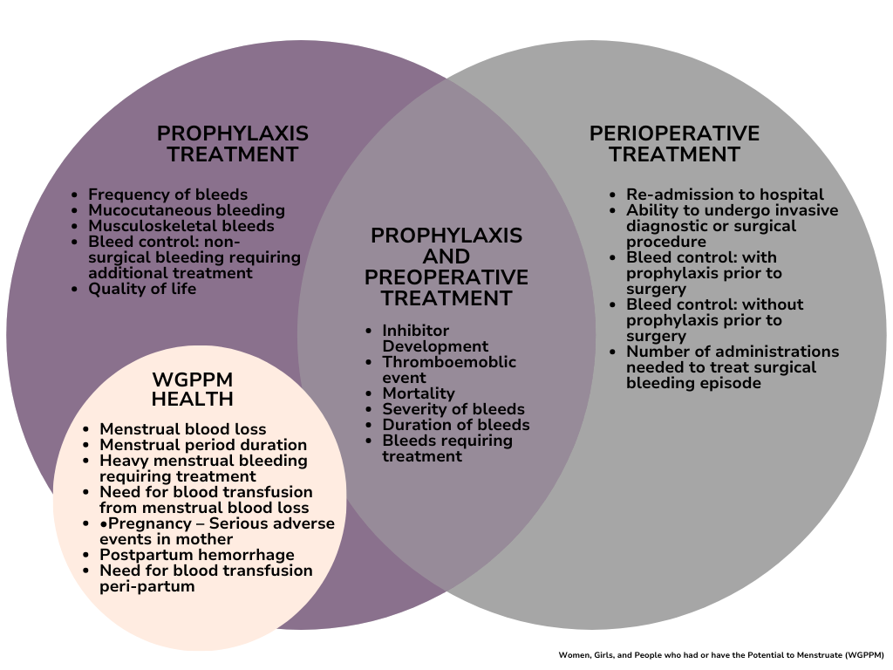

Slide 73
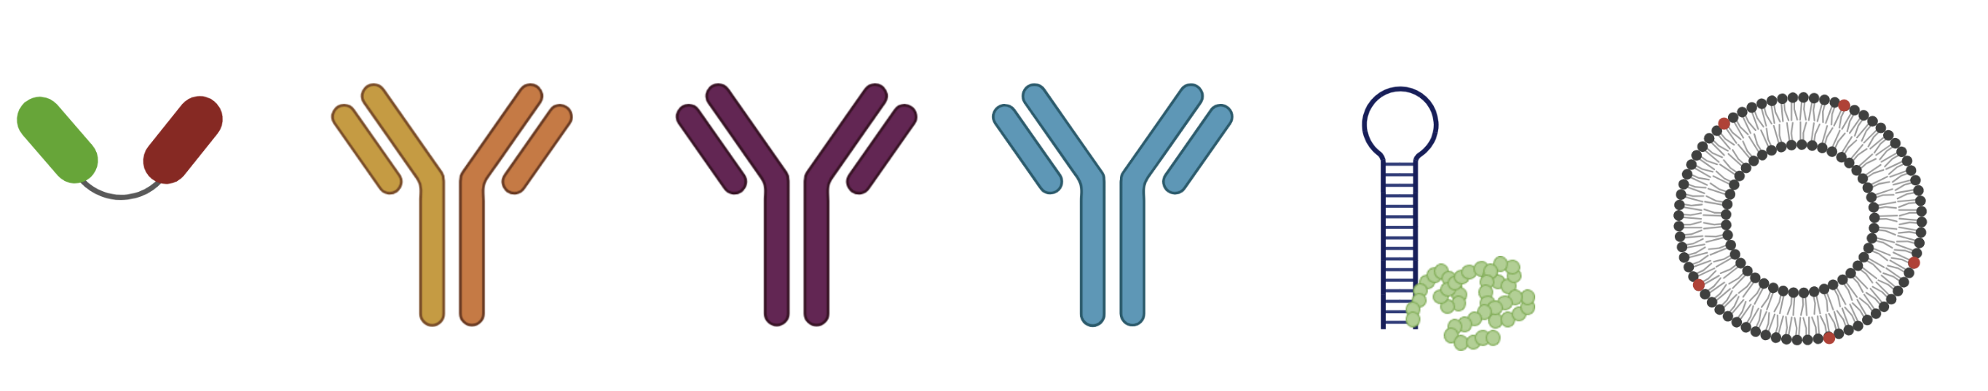
New and Emerging Therapies for VWD
emicizumab
BT200
VGA039
HMB-001
platelet inspired nanoparticles
KB-V13A12
Casari, Caterina

Slide 74
What is the impact of coreVWD?
Multi-stake holder consensus
Clear expectations for clinical trials
Guidance on outcomes of importance

Slide 75
What does this mean for patients?
Improve quality and applicability of clinical trials
Allow comparison across options
Make informed best choice

Slide 76
Importance of NMO involvement
Heavy menstrual bleeding not previously considered a bleeding episode in trials designed for men
  MUST be measured in VWD clinical trials
Concrete activity in support of VWD patients

Slide 77
How can NMOs be involved?
Understand Core Outcome Set
Share this knowledge with members
Advocate for its use in clinical trials
Publicize it to patients, health care providers, policy makers, payers

Slide 78
How can NMOs be involved?
Emphasize the importance of the voices of those with lived experience in clinical trials
Use it as a reference in education and awareness campaigns
Inform data collection efforts (databases, registries, observational studies)
Disseminate the results widely

Slide 79
How can NMOs be involved?
Guide emerging efforts focused on VWD
Inform discussion with industry partners

Slide 80
coreVWD Supporters
Dawn Rotellini
Emily Ayoub
Sarah Ford
Manon Degenaar-Dujardin

Slide 81
Next steps
Determine HOW to measure outcomes

Slide 82
coreVWD Conclusions
Multi-stake holder project to determine core outcomes for VWD clinical trials
Many other benefits and uses of the COS
Responsibility to advocate for clinical trials that serve VWD patients and improve their lives

Slide 83
Acknowledgements
coreVWD Delphi Panel
Advisory Board and Project Team
Project Support
Rezan Abdul-Kadir
Barbara Ameer
Foluso Agboola
Callie Berkowitz
Vanessa R. Byams
Jorge Caicedo
Ronia Cole
Megan Conboy
Susie Couper
Susan Cutter
Tuende Czirok
Kim-Hien Dao
Matt Delaney
Alison Dougall
Jeroen Eikenbook
Violeta Farah
Nicholas Giraud
Jim Gilbert
Dawn Goodyear
Jean Grow
Bernd Jilma
Caitlin Jones
Craig Kessler
Gavin Ling
Nick McRae-Cyr
Sunny Maini
Maia Meier
Gary Patou
Ed Pezalla
Margaret Ragni
Tara Robinson
Sandra Santos
Nikole Scappe-Hagen
Mukta Sharma
Michelle Sholzberg
Robert Sidonio
Penni Smith
Lisa Thibeault
Pam Wilton
Baiba Ziemele
Canadian Hemophilia Society
European Haemophilia Consortium
National Bleeding Disorders Foundation
World Federation of Hemophilia
Emily Ayoub
Elizabeth Clearfield
Nathan T. Connell
Manon Degenaar-Dugardin
Veronica Flood
Sarah Ford
Paula James
Alexandra Kucher
Ben Kim
Michelle Lavin
Dawn Rotellini
Mark Skinner
Sponsors
Band Therapeutics
BioMarin
Star Therapeutics/ Electra Therapeutics
Roche
Takeda

Slide 84
THANK YOU!

