Slide 1

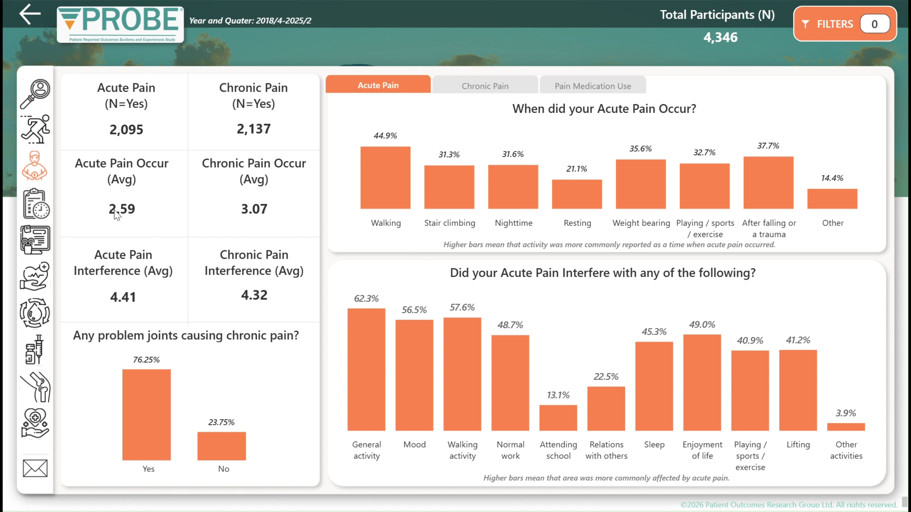
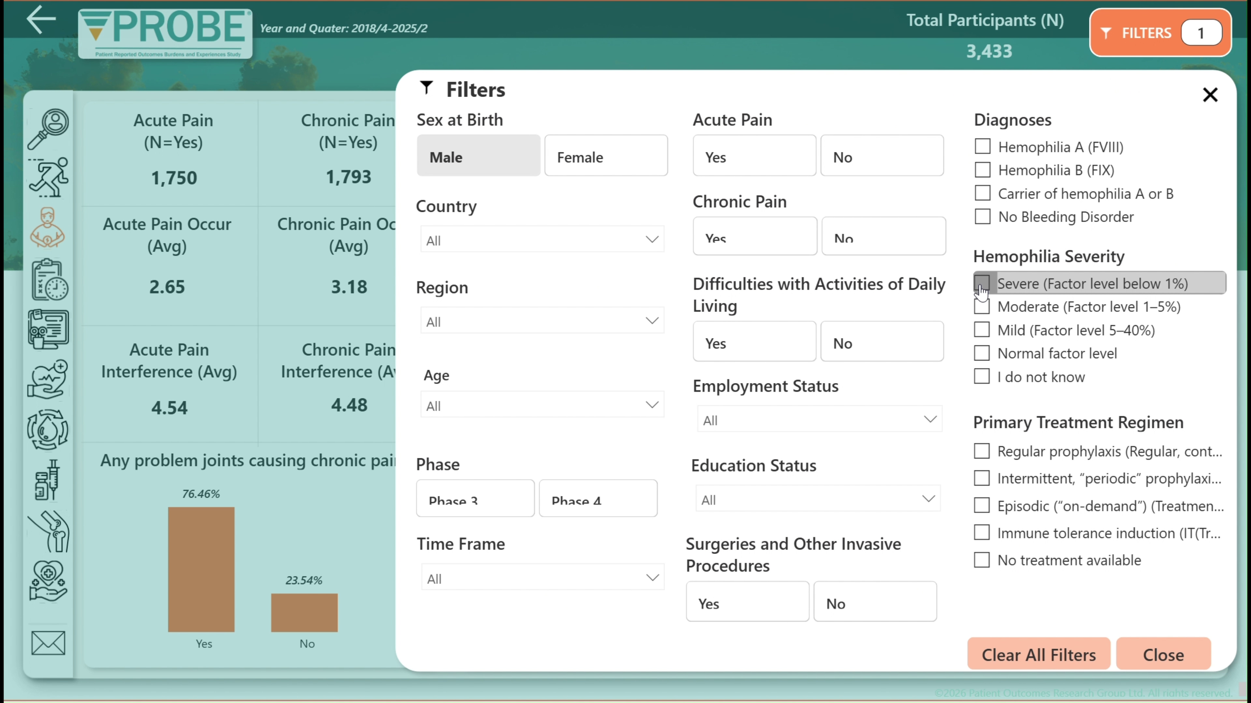
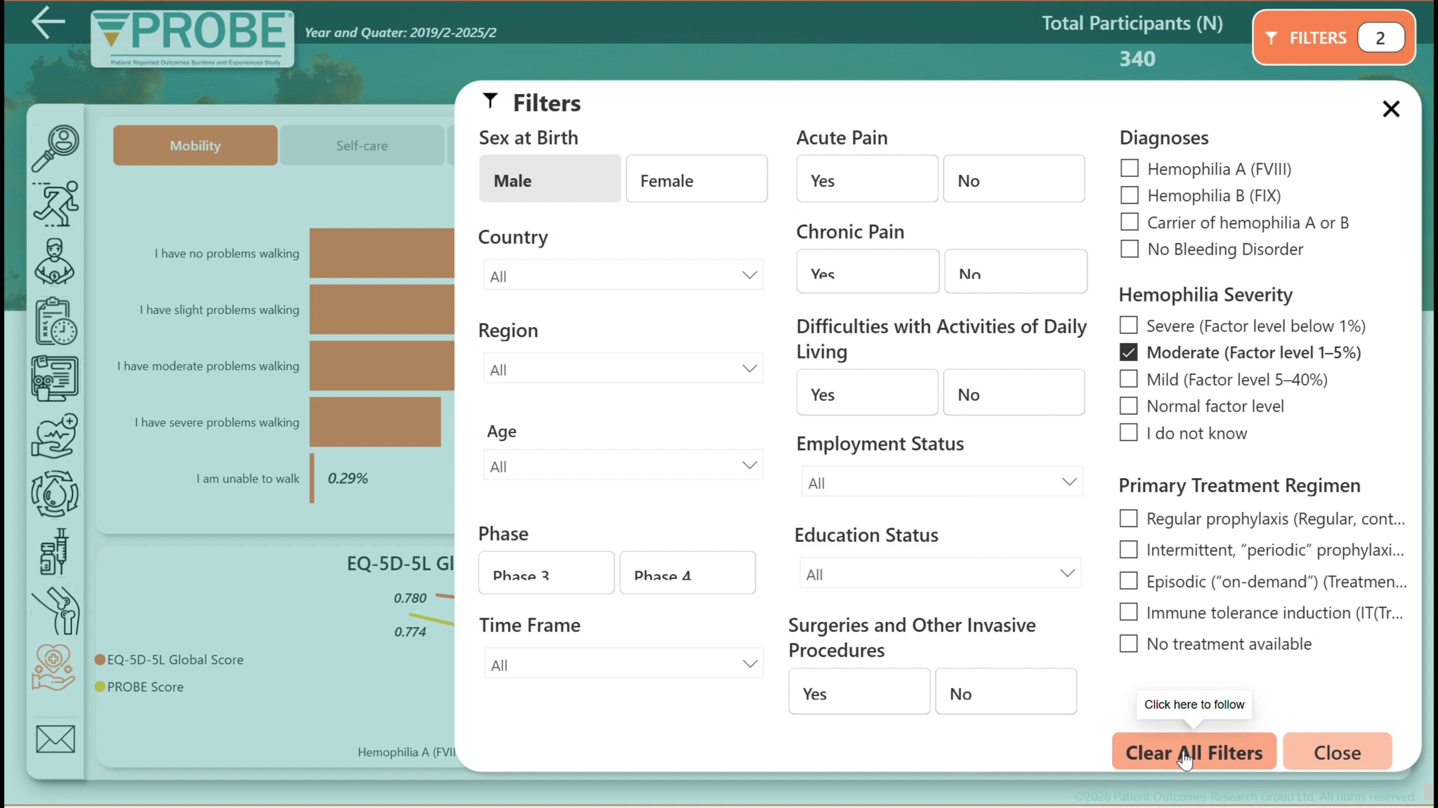

Development of a refined data dashboard for PROBE
Enhancing data interpretation and advocacy support for national patient organizations
WFH Congress 2026 • Oral presentation • 9 min total
Presented by Mark W. Skinner
Prepared by Alexandra (Sasha) Kucher
A refreshed Power BI dashboard for clearer quality-of-life reporting, faster interpretation, and stronger advocacy support.
PROBE Dashboard • Oral presentation
Opening
1
Notes:
Good evening, and thank you for the opportunity to present today.
Our abstract is titled Development of a refined data dashboard for PROBE: Enhancing data interpretation and advocacy support for national patient organizations.
The PROBE study has collected standardized quality-of-life data for many years, and this work focused on redesigning the PROBE dashboard to make those data easier to interpret, easier to communicate, and more useful for advocacy and reporting.
In this presentation, I will briefly explain why the dashboard was redesigned, what was built in Power BI, how users can interact with it, and why this matters for national member organizations and future PROBE work.
[Timing]
0:45

Slide 2
Disclosures for: Mark W. Skinner JD
Conflict | Disclosure – if conflict of interest exists
Research Support | Institution received research project support from Band, Biomarin, Chugai, CSL, Roche, Pfizer, Sanofi, Spark, Takeda, Vega
Director, Officer, Employee | EPOCH Ltd., ICER, Institute for Policy Advancement Ltd., McMaster University, NORD, Patient Outcomes Research Group Ltd., WFH USA
Shareholder | n/a
Honoraria | Institution received honoraria or fees from: Bayer, Enzyre, Novo Nordisk, Regeneron, Genentech, Sanofi, Sobi, Takeda
Advisory Committee | DSMB - Pfizer
Consultant | NBDF
PROBE Dashboard • Oral presentation
Disclosures
2

Slide 3
Why redesign the dashboard?
The need grew as PROBE participation and reporting uses expanded.
The original dashboard was valuable — but PROBE needed a tool that could better support flexible interpretation, local advocacy, and scientific communication.
Redesign goals
Improve visualization and interpretation of PROBE quality-of-life data
More participating patient organizations
Semi-annual data collection across countries created a larger and more diverse PROBE dataset.
Make abstracts, reports, and presentations faster to prepare
More reporting use cases
Enable clearer country-level or subgroup comparisons
National organizations increasingly needed figures and summary tables for abstracts, reports, presentations, and advocacy briefs.
Create a scalable foundation for future PROBE modules
More need for visual depth
Users wanted a dashboard that was more intuitive, filterable, visually rich, and easier to interpret in real time.
Core message: make PROBE data easier to turn into local evidence and action.
PROBE Dashboard • Oral presentation
Background
3
Notes:
As PROBE participation continued to grow across countries, the need for a more flexible and intuitive dashboard also became clear.
The original dashboard was valuable, but over time we saw increasing demand for a tool that could better support multiple real-world uses. National patient organizations needed a faster way to explore data, create visuals for reports and presentations, and communicate findings more clearly for local advocacy.
So the redesign was driven by three main needs: first, a growing and more diverse dataset from ongoing semi-annual collection; second, more reporting use cases across abstracts, reports, and presentations; and third, a stronger need for visual depth and easier interpretation.
Our core goal was simple: to make PROBE data easier to turn into meaningful local evidence and action.
Timing: 1:00

Slide 4

What we built in Power BI
A monthly refreshed, theme-based dashboard connected to the central PROBE database.
Monthly refresh
Updated monthly from the central PROBE database
Theme-based pages
Demographics, difficulty with activities of daily living, pain, work/education, joints, treatment, scores, and much more
Interactive filtering
Age, severity, inhibitor status, country, collection period, and related variables
Export-ready outputs
Figures and summary tables that can support reporting and communication
The redesign also drew on feedback from patient organizations, clinicians, and patient partners.
PROBE Dashboard • Oral presentation
Methods
4
Notes:
To address those needs, we redesigned the existing PROBE dashboard in Microsoft Power BI.
The dashboard is updated monthly and connected to the central PROBE database. It organizes key PROBE metrics, including PROBE Score and EQ-5D-5L, into theme-based pages such as demographics, activities of daily living, pain, employment and education, severity and inhibitor status, treatment, joints, and utility scores.
A key feature is interactive filtering. Users can stratify data by variables such as age, severity, inhibitor status, world regions, and collection period. This allows them to tailor the view to the exact subgroup or context they want to explore.
The dashboard was also designed to support export-ready figures and summary tables, which makes it more practical for reporting and communication. Importantly, the redesign was informed by feedback from NMOs, clinicians, and patient partners.
[Timing]
1:00

Slide 5

90-second dashboard walkthrough
At this point in the oral presentation, play the short demo video.
PROBE Dashboard • Oral presentation
Video
5
Notes:
“Now, please watch a short 90-second dashboard walkthrough to demonstrate how the tool works in practice.
After video ends:
This short demo highlights how quickly users can move across pages, apply filters, and identify the information most relevant to their needs.
[Timing]
1:30 (video)

Slide 6
What users can do in seconds
The dashboard is designed for fast navigation, filtering, and reporting.
A practical workflow for patient organizations
1
Move across themed pages
Use the left navigation to go directly to pain, employment, severity, treatment, joints, or scores.
2
Tailor the population
Apply filters for age, severity, inhibitor status, country, and collection phase or period.
3
Compare patterns
Deep-dive pages support subgroup comparison and more focused discussion.
4
Use the outputs
Export figures and summary tables for local presentations, reports, abstracts, or advocacy briefs.
PROBE Dashboard • Oral presentation
User experience
6
Notes:
One of the major strengths of the redesigned dashboard is speed of use.
Users can move directly across themed pages using the left-side navigation, without needing to return to a home page each time. They can then apply filters to tailor the population of interest, for example by age, time frame, diagnoses severity or even customize their filters upon the request.
Within each theme, deeper views support subgroup comparisons and more focused discussion. This is especially useful when users want to explore patterns in a national cohort or compare outcomes across specific clinical groups.
Finally, the outputs can be used directly in local presentations, reports, abstracts, and advocacy briefs. So the dashboard is not only interactive, but also practical for communication and reporting.
[Timing]
1:00

Slide 7
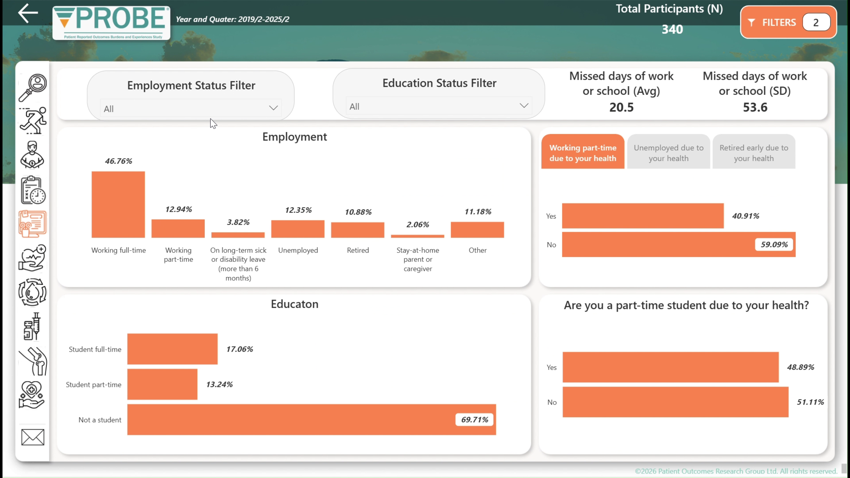
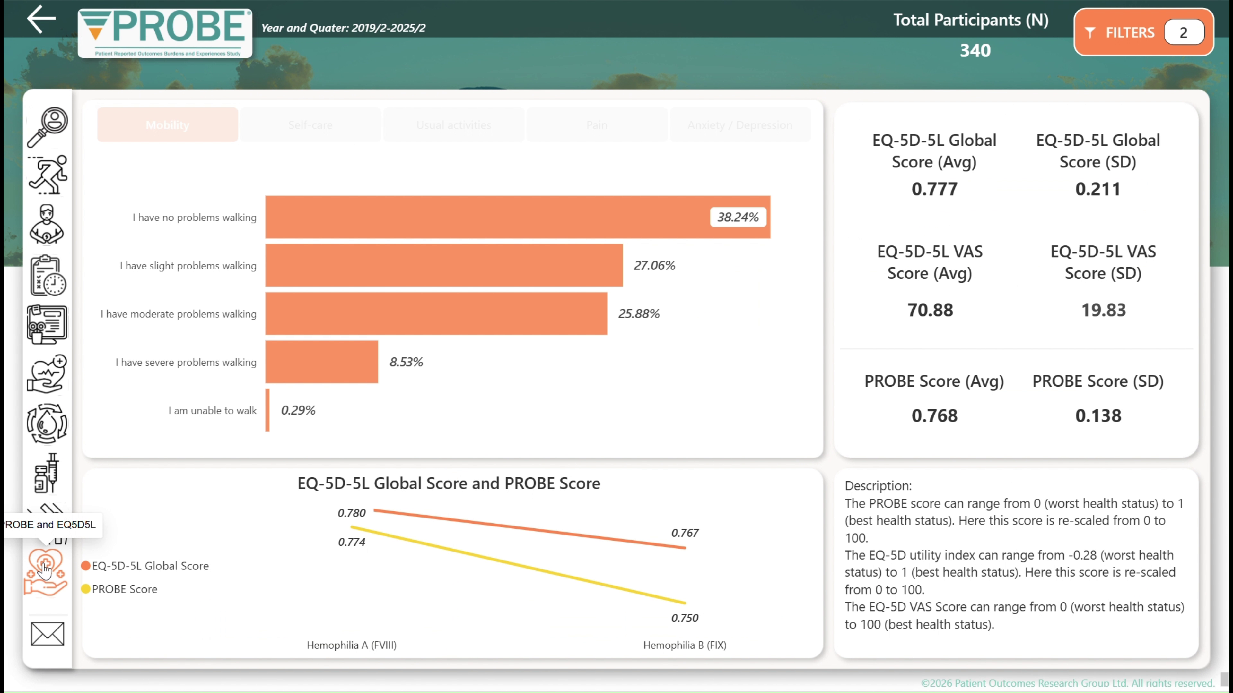
What the dashboard helps reveal
Interactive charts make quality-of-life patterns easier to spot and discuss.
Pain burden
Employment & education
Severity / inhibitors
The dashboard surfaces interpretable patterns across multiple quality-of-life domains:
Resulting value
Patient organizations can move more quickly from descriptive data to focused, data-driven messages for advocacy and clinical quality improvement.
Mobility and activities of daily living
Acute and chronic pain burden
Employment and education status
Key point: the redesign improves clarity, not just aesthetics.
Treatment patterns and joint outcomes
PROBE and EQ-5D-5L scores
PROBE Dashboard • Oral presentation
Results
7
Notes:
The value of the dashboard is not only in navigation, but in what it helps reveal.
Interactive charts and tables make it much easier to identify patterns across multiple quality-of-life domains. These include but not limited to mobility and activities of daily living, acute and chronic pain burden, employment and education, treatment patterns, joint outcomes, and PROBE and EQ-5D-5L scores.
Deep-dive views within each theme support more detailed interpretation, such as comparing your country outcomes by diagnoses or regions. This helps users move beyond simply viewing numbers and toward discussing what those patterns may mean in practice.
So the redesign improves clarity, not just aesthetics. It supports faster interpretation of results and helps patient organizations translate data into focused, evidence-based messages.
[Timing]
1:15

Slide 8

Why this matters for national patient organizations and advocacy
The redesigned dashboard helps turn PROBE data into communication-ready evidence.
From dashboard to action
Faster communication products
Standardized visuals and summaries simplify abstracts, reports, and oral presentations.
Stronger advocacy messages
Country-level or subgroup patterns can be translated into clearer, evidence-based messages for stakeholders.
Support for quality improvement
Clinicians, national member organizations, and patient partners can use the same visual language to discuss gaps and progress.
The dashboard strengthens the bridge between data interpretation and advocacy use.
PROBE Dashboard • Oral presentation
Advocacy value
8
Notes:
This redesign is especially important for national member organizations.
A major challenge for many patient organizations is not just access to data, but access to data in a form that is easy to understand, communicate, and use. The redesigned dashboard helps bridge that gap.
Standardized visuals and summaries can support faster preparation of abstracts, reports, and oral presentations. At the same time, country-level or subgroup-level findings can be translated into clearer advocacy messages for stakeholders, including clinicians, policymakers, and partners.
In that sense, the dashboard strengthens the link between data interpretation and action. It gives NMOs a more communication-ready way to use PROBE findings for advocacy and quality improvement.
[Timing]
1:00

Slide 9
A platform for future PROBE modules
The redesign was also built with scalability in mind.
The same framework can support additional PROBE modules and broader rare bleeding disorder communities.
Women with bleeding disorders
von Willebrand
disease
Other rare bleeding / platelet disorders
Imagination is the limit
Take-home message: this is not just a better dashboard for today — it is an expandable infrastructure for future patient-reported outcome work across bleeding disorders.
PROBE Dashboard • Oral presentation
Future modules
9
Notes:
Another important aspect of this work is scalability.
The dashboard was not redesigned only for current PROBE use, but also as a foundation for future development. The same structure can support additional PROBE modules and broader rare bleeding disorder communities.
This includes future work related to women with bleeding disorders, von Willebrand disease, and other rare bleeding or platelet disorders.
So this is not simply a better dashboard for today. It is an expandable framework that can support future patient-reported outcome work across a wider range of bleeding disorders.
[Timing]
0:45

Slide 10

Thank you
Enhanced access to clear, interpretable PROBE and EQ-5D-5L indicators can help patient organizations monitor outcomes, inform policy, and strengthen patient-centered care.
Final take-home points
Designed with NMOs and patient partners in mind
Built for faster interpretation, cleaner reporting, and stronger advocacy
Scalable for future PROBE modules and broader bleeding disorder communities
Questions?
Presented by Mark W. Skinner
Prepared by Alexandra (Sasha) Kucher (akucher@probestudy.org)
PROBE Dashboard • Oral presentation
Close / Q&A
10
Notes:
In conclusion, the refined PROBE dashboard offers patient organizations a more user-friendly and effective way to interpret quality-of-life data.
By improving access to clear, interpretable PROBE and EQ-5D-5L indicators, the dashboard can support monitoring of outcomes, stronger reporting, better-informed advocacy, and more patient-centered care.
This dashboard helps turn PROBE data into accessible evidence that patient organizations can use to communicate needs, support advocacy, and strengthen patient-centered care. Thank you..
[Timing]
0:30 + Q&A

