Slide 1


Welcome!
and
Patient-centered research, collaboration, and data innovation at WFH 2026
Session Highlights:
PROBE enhancements and implementation updates
Global research examples and country trach
A first look at the refined PROBE dashboard
New developments in WAPPS and Calibra
Discussion, questions, and collaboration
Date
Time
21 April 2026
7:15–8:15 AM
Venue
Room
Kuala Lumpur Convention Centre
MR 302, 3rd Level

Slide 2
Agenda and Speaker Information
and
Breakfast meeting program and featured speakers
Meeting Agenda
Featured Speakers
Welcome and Opening Remarks | Mark Skinner welcomes attendees and sets the stage for a conversation focused on collaboration, innovation, and patient voice.
Speaker Introductions | Brief introductions of presenters and contributors to frame the session and areas of expertise.
PROBE Enhancements | Elizabeth Clearfield shares recent developments in PROBE, including progress related to VWD, rare bleeding disorders, and women and girls with bleeding disorders.
Global Research in Action | Examples from participating countries, including Brazil and Kyrgyzstan, illustrating the expanding international footprint and value of PROBE implementation.
Debut of the New PROBE Dashboard | Mark Skinner shows a first look at the refined dashboard experience, designed to make data more accessible, engaging, and actionable for stakeholders.
Updates from WAPPS and Calibra | Arun Keepanasseril presents new developments across the WAPPS and Calibra platforms and their relevance to the community.
Discussion and Q&A | Open discussion with attendees to exchange ideas, answer questions, and explore opportunities for partnership and impact.
Mark W. Skinner
President/CEO, Institute for Policy Advancement, Ltd.; President/CEO, Patient Outcomes Research Group Ltd.
Elizabeth Clearfield
Senior Research Manager, Institute for Policy Advancement, Ltd.
EClearfield@ipaltd.com
Arun Keepanasseril
Director of Operations, Canadian Bleeding Disorder Registry; Assistant Clinical Professor (Adjunct)
Keeppaa@mcmaster.ca
NMO and Dashboard Contact
Alexandra (Sasha) Kucher
Senior Research Data Manager
AKucher@probestudy.org

Slide 3
PROBE Enhancements
and
Section Highlights:
Elizabeth Clearfield
Women’s Module
Enhancing PROBE for VWD
Other Rare Bleeding Disorders
Senior Research Manager, Institute for Policy Advancement, Ltd.
EClearfield@ipaltd.com

Slide 4

PROBE Enhancements
Measuring What’s Important
Pain - chronic/acute, interference, occurrence
Independence - limitations, impact on activities of daily living
Education - attainment, attendance
Employment - duration, underemployment, attendance
Family life - marriage, children
Mobility - assistance required, impairment
Current health status - (EQ-5D-5L / VAS)

Slide 5
PROBE Enhancements – Women’s Module
Development Approach
Steps to a New PROBE Module
1
2
EVIDENCE REVIEW
CONCEPTUAL FRAMEWORK
Identification of missing domains in women-specific experiences
Inclusion of menstrual health, access to care, reproductive health, and social impact
3
4
EXPERT COLLABORATION
MODULE INTEGRATION
Input from patients, patient advocates and the WFH, EHC, CoA, NBDF, and CHS
Development and pilot testing of 11 WBD-specific questions

Slide 6
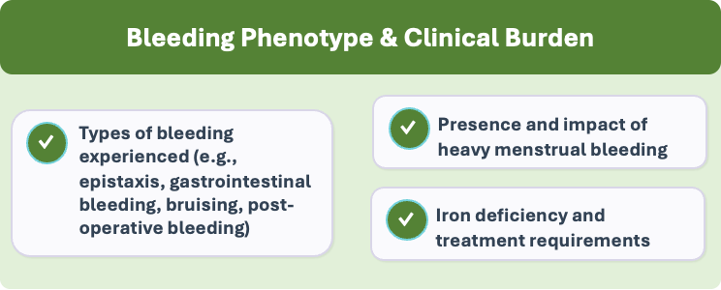
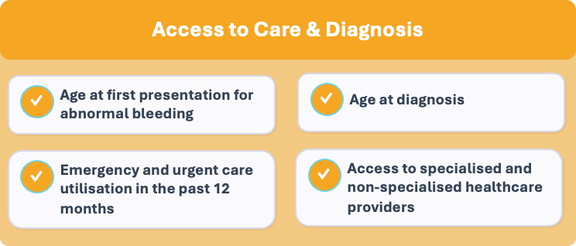

Slide 7
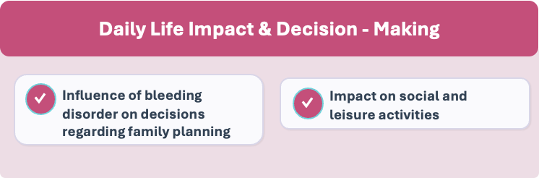
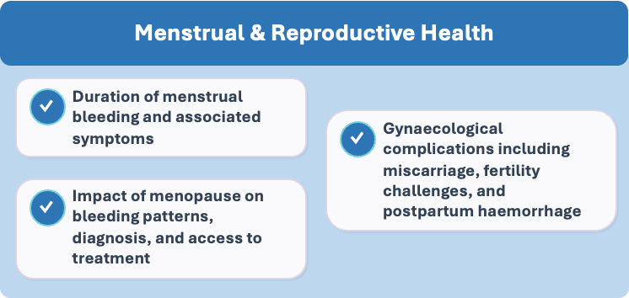

Slide 8
PROBE Enhancements
New Additions and Changes to the PROBE Study
Added all bleeding disorders | Von Willebrand Disease (VWD), platelet disorder, rare factor deficiency
Additional treatments | Expanded factor concentrates and therapies, platelet transfusions, iron treatments, and other
Diagnoses | age of diagnoses, abnormal bleeding episodes
Health care professional Access | Medical professional / services access, urgent care visits
Added bleeding events | Nosebleeds, easy bruising, heavy menstrual bleeding
Gynecological | menopause, changes in treatment/access to treatment, gynecological issues
Quality of Life | decision to have children, impact on social/leisure life

Slide 9
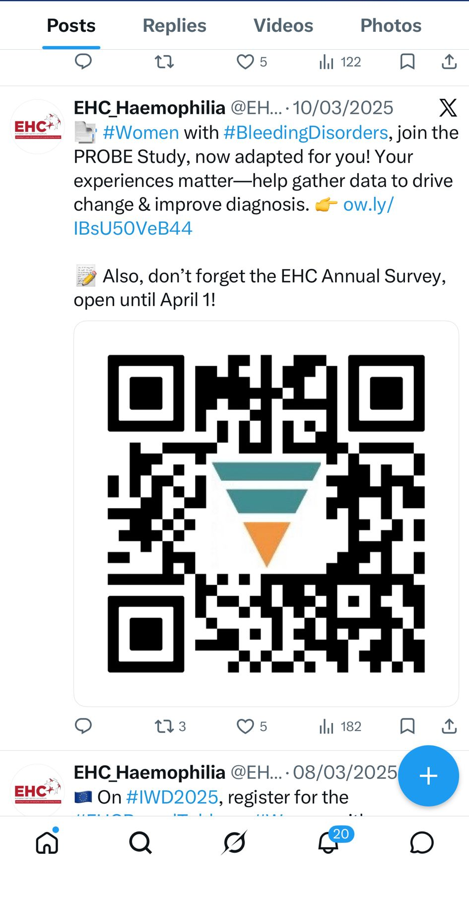
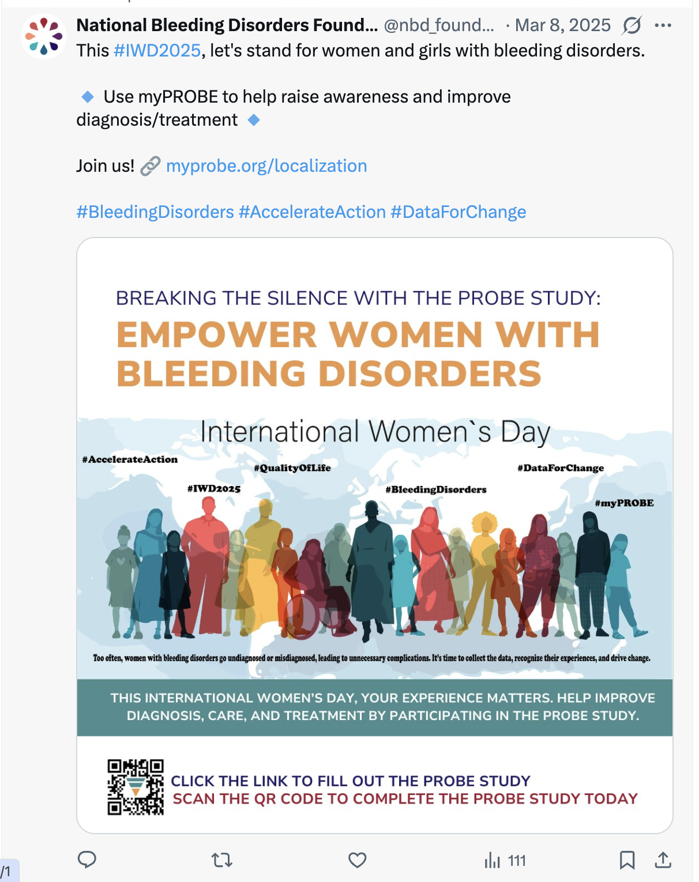
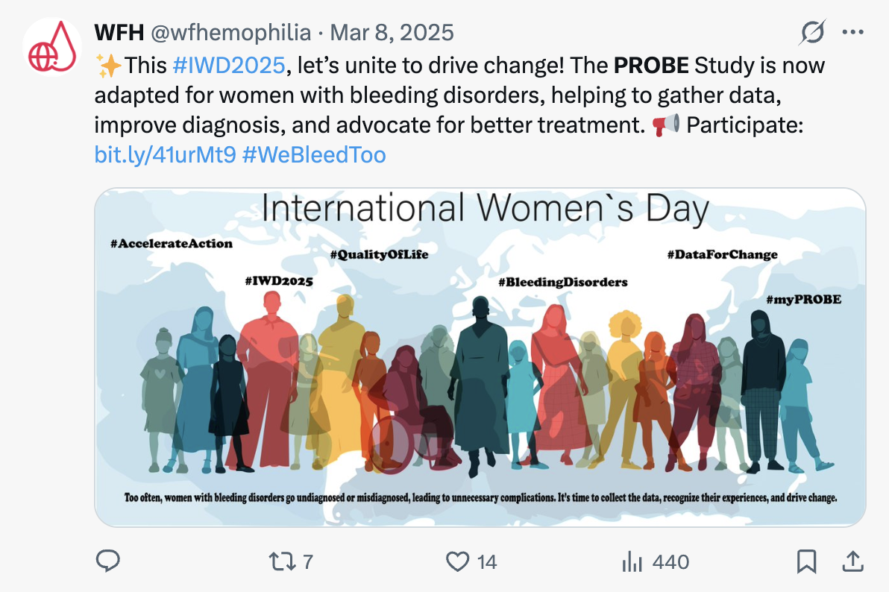

Slide 10
PROBE Enhancements – Women’s Module
New Module Metrics
Key Findings
11
New Items in Women’s Module
20.5
Average Age at Diagnosis
Average Menstrual Period Length
5
Key languages for pilot study
10.6
64
Participants To Date
9
Emergency Room visits in the past 12 months
up to

Slide 11
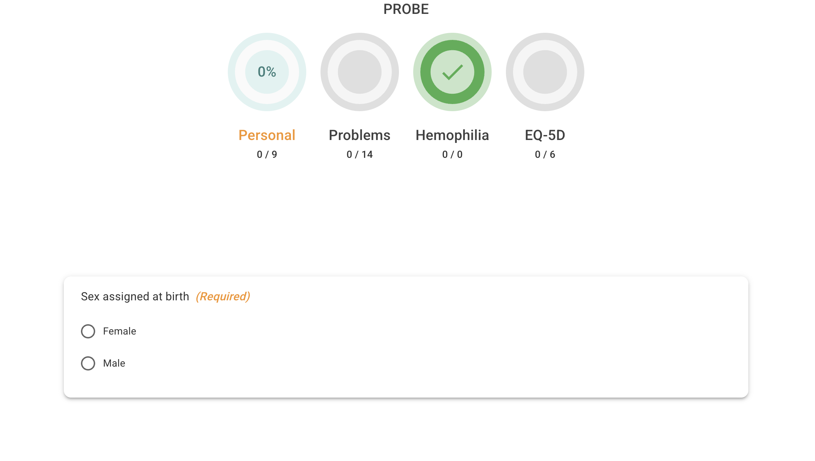
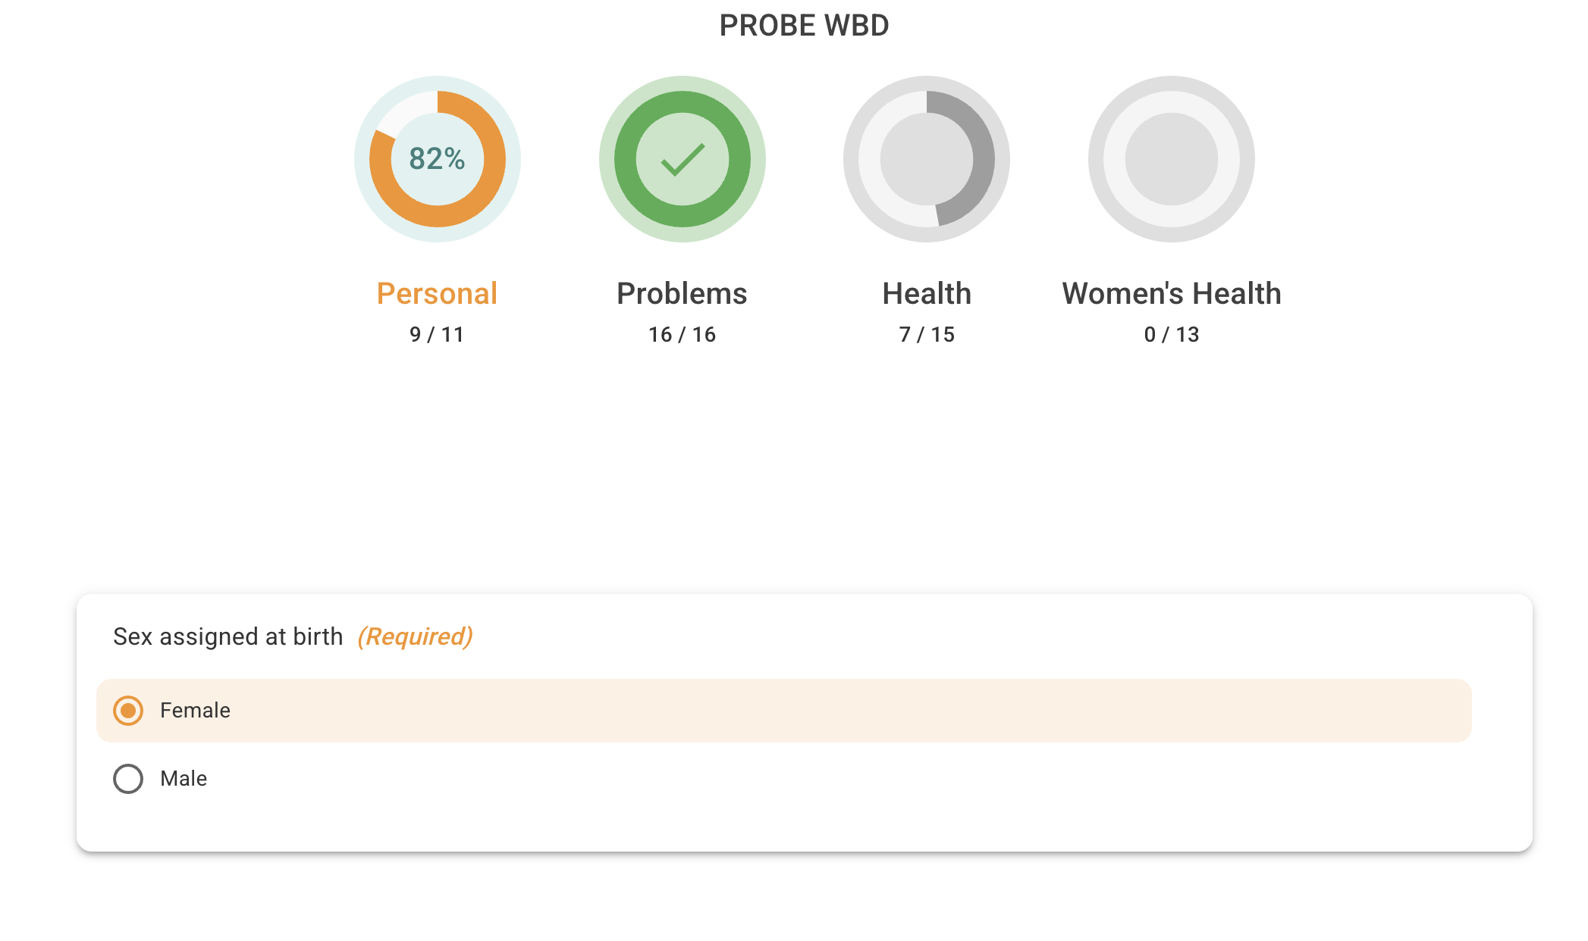
PROBE Enhancements – Women’s Module

Slide 12
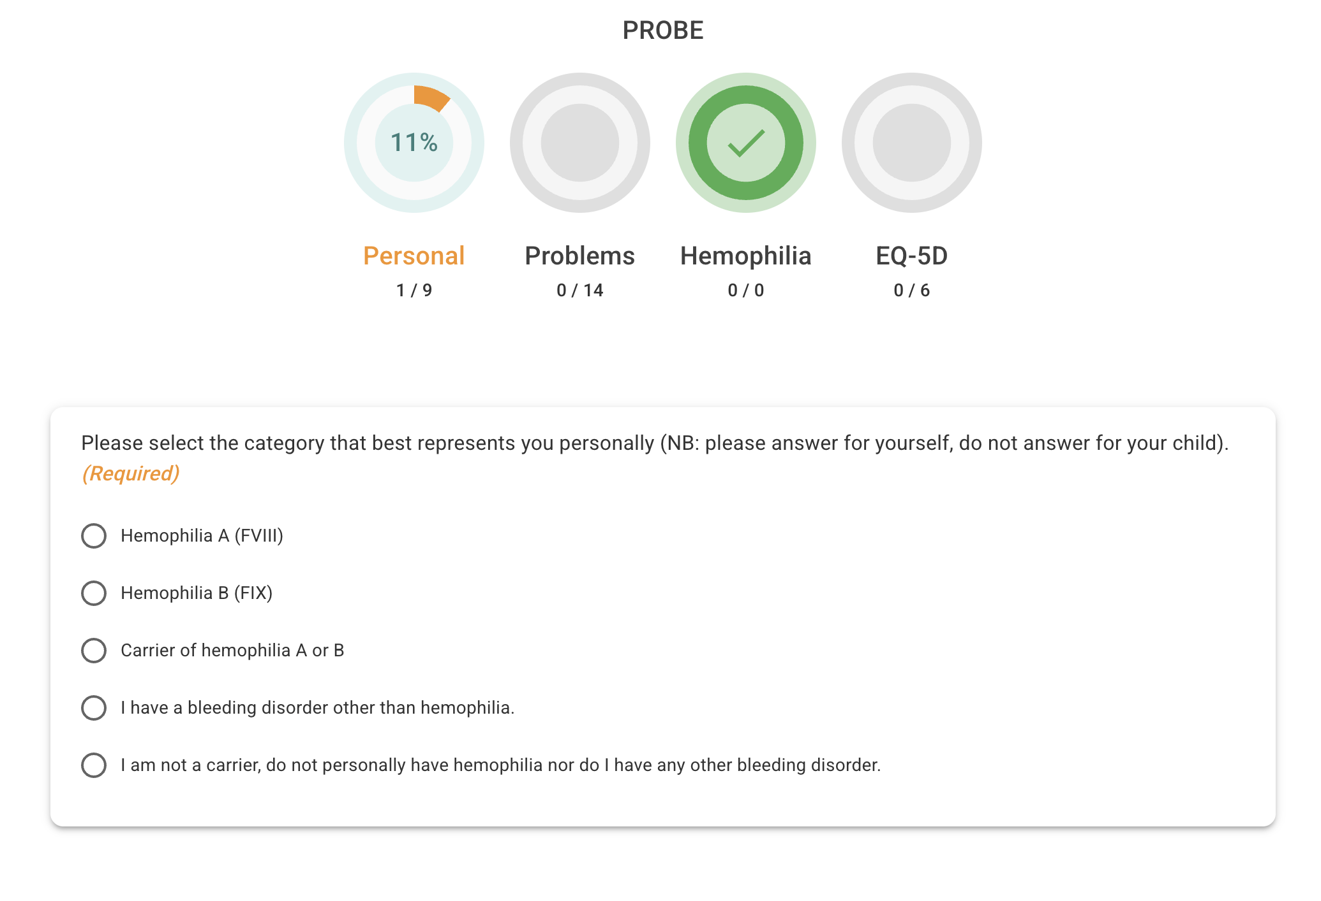
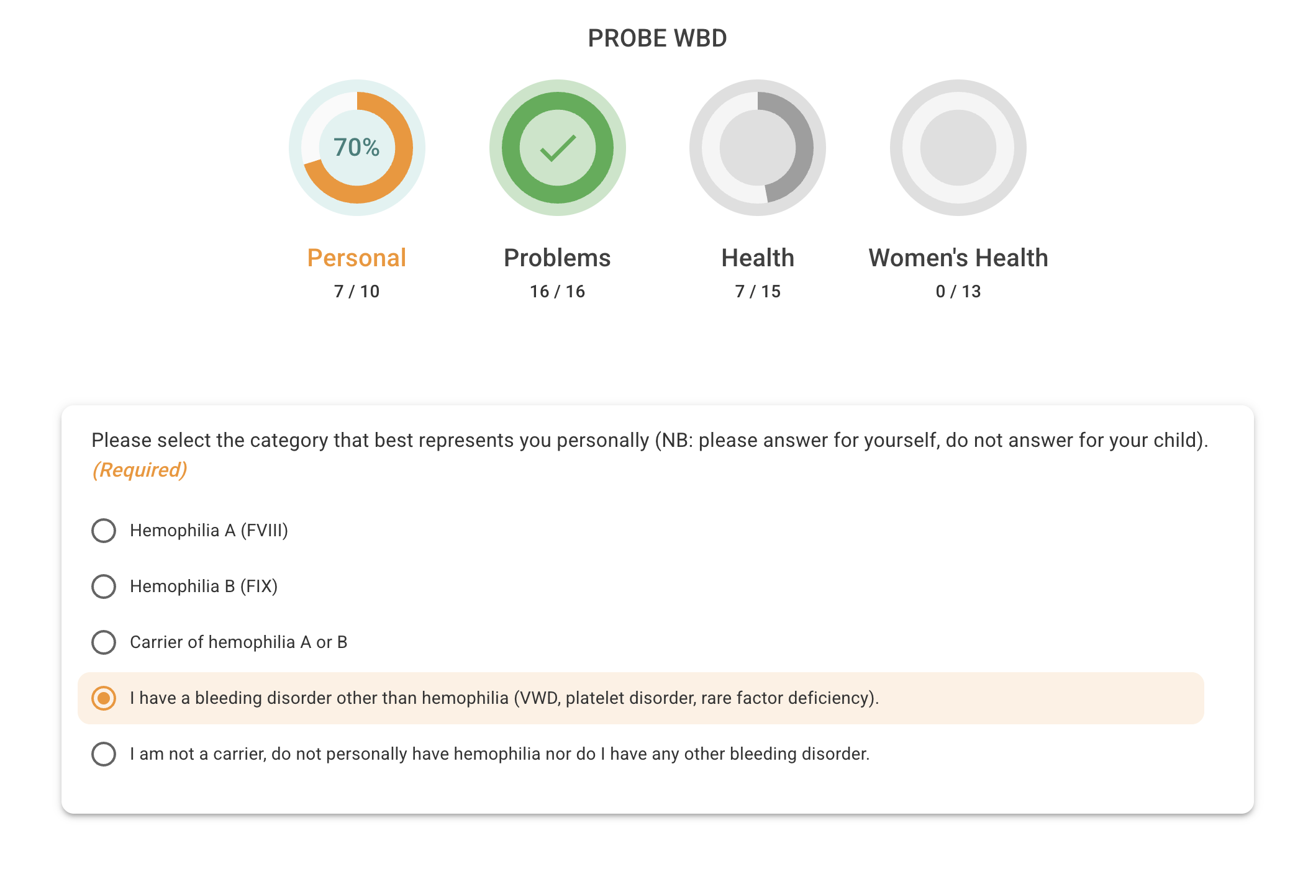
PROBE Enhancements – Rare Disease

Slide 13
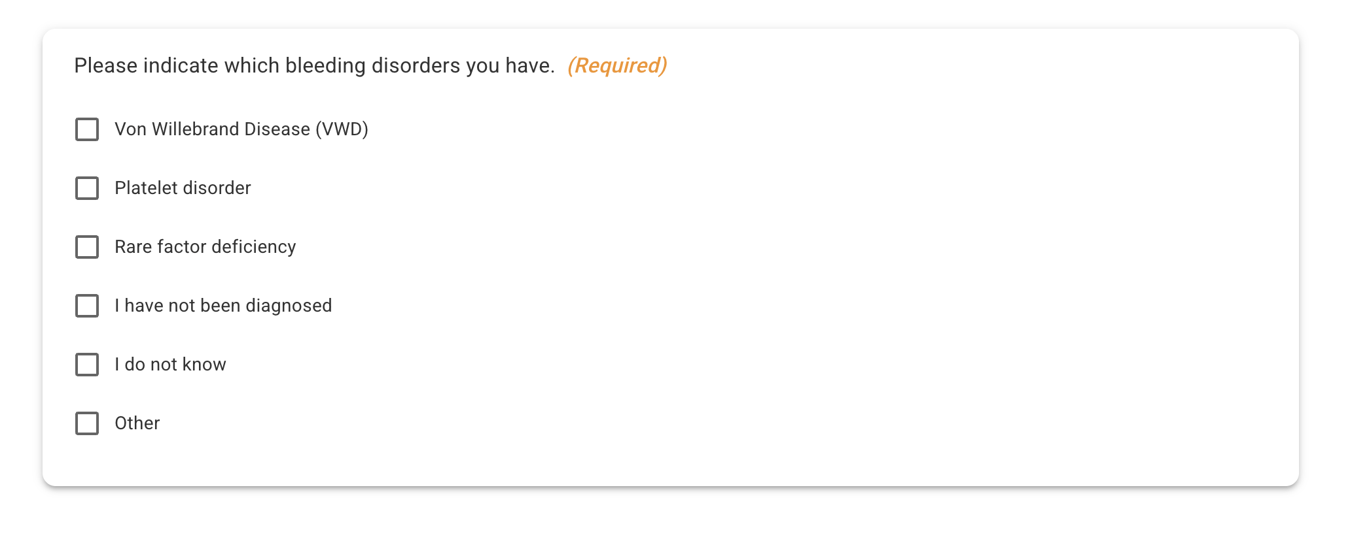
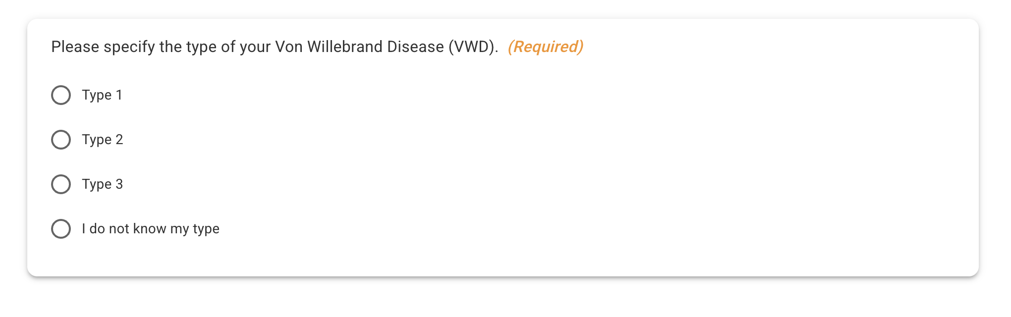
Notes:
If you say type 1 or 2 then it further asks your subtype, you can also say you do not know

Slide 14
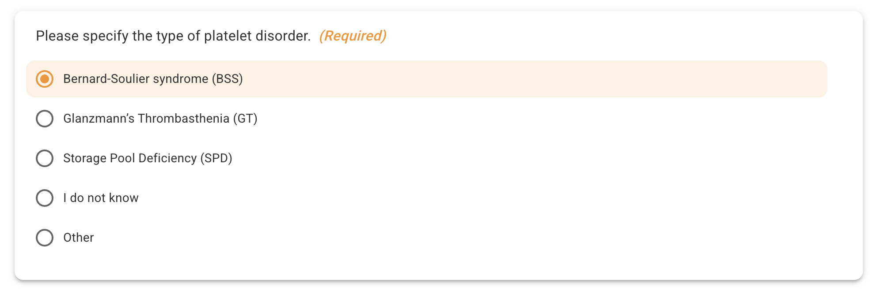
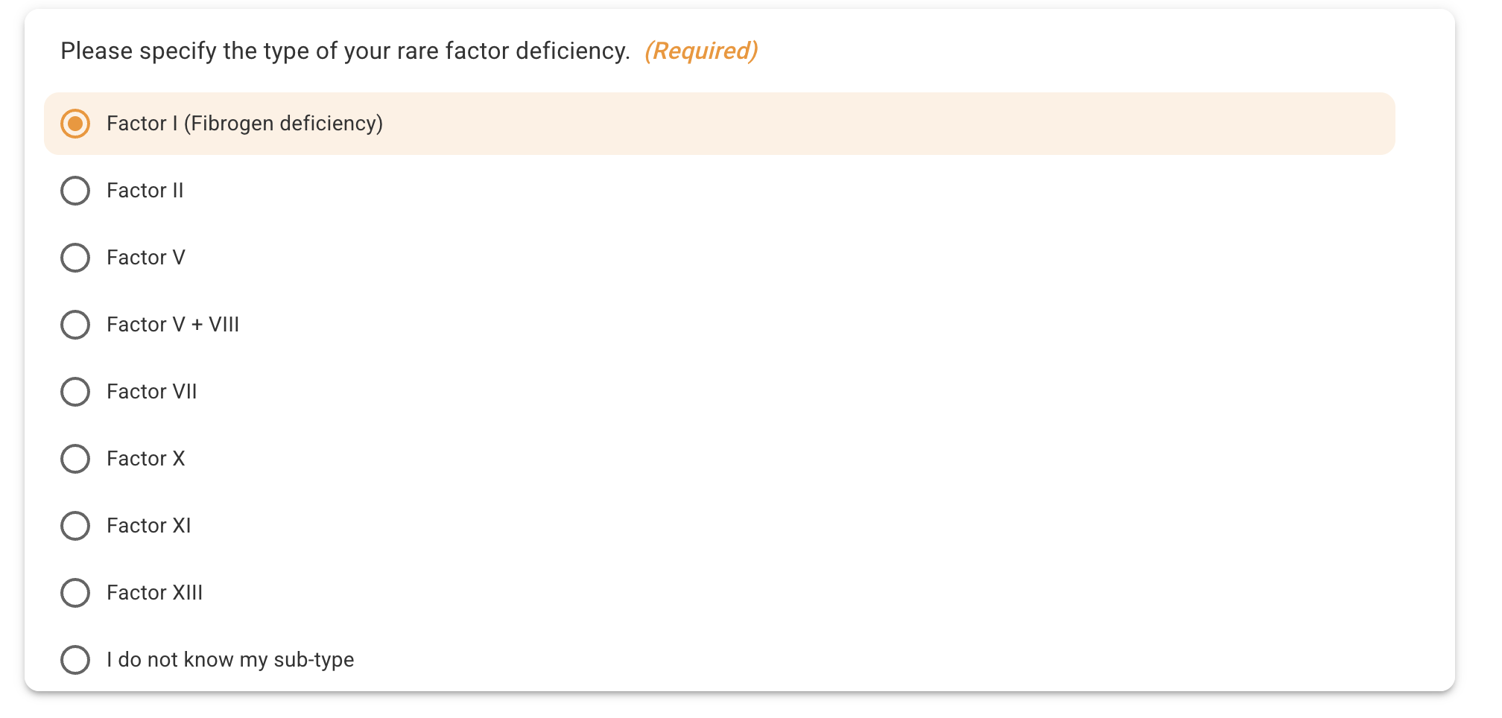

Slide 15
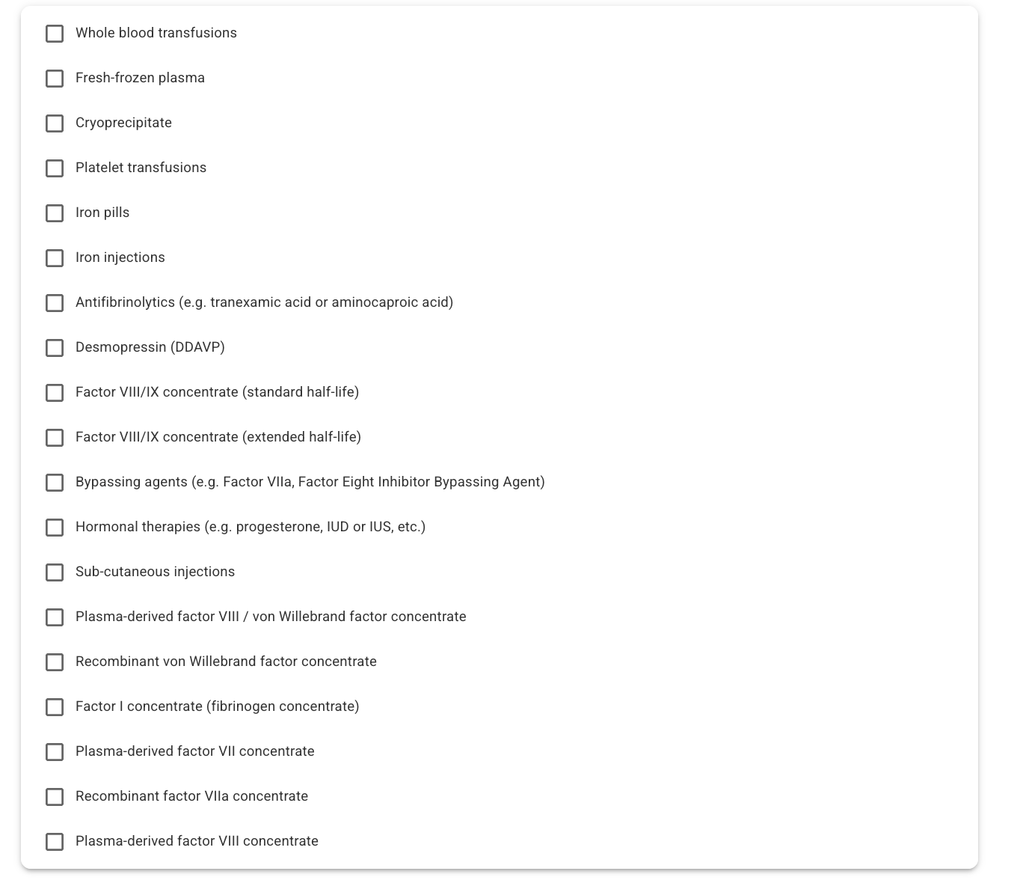
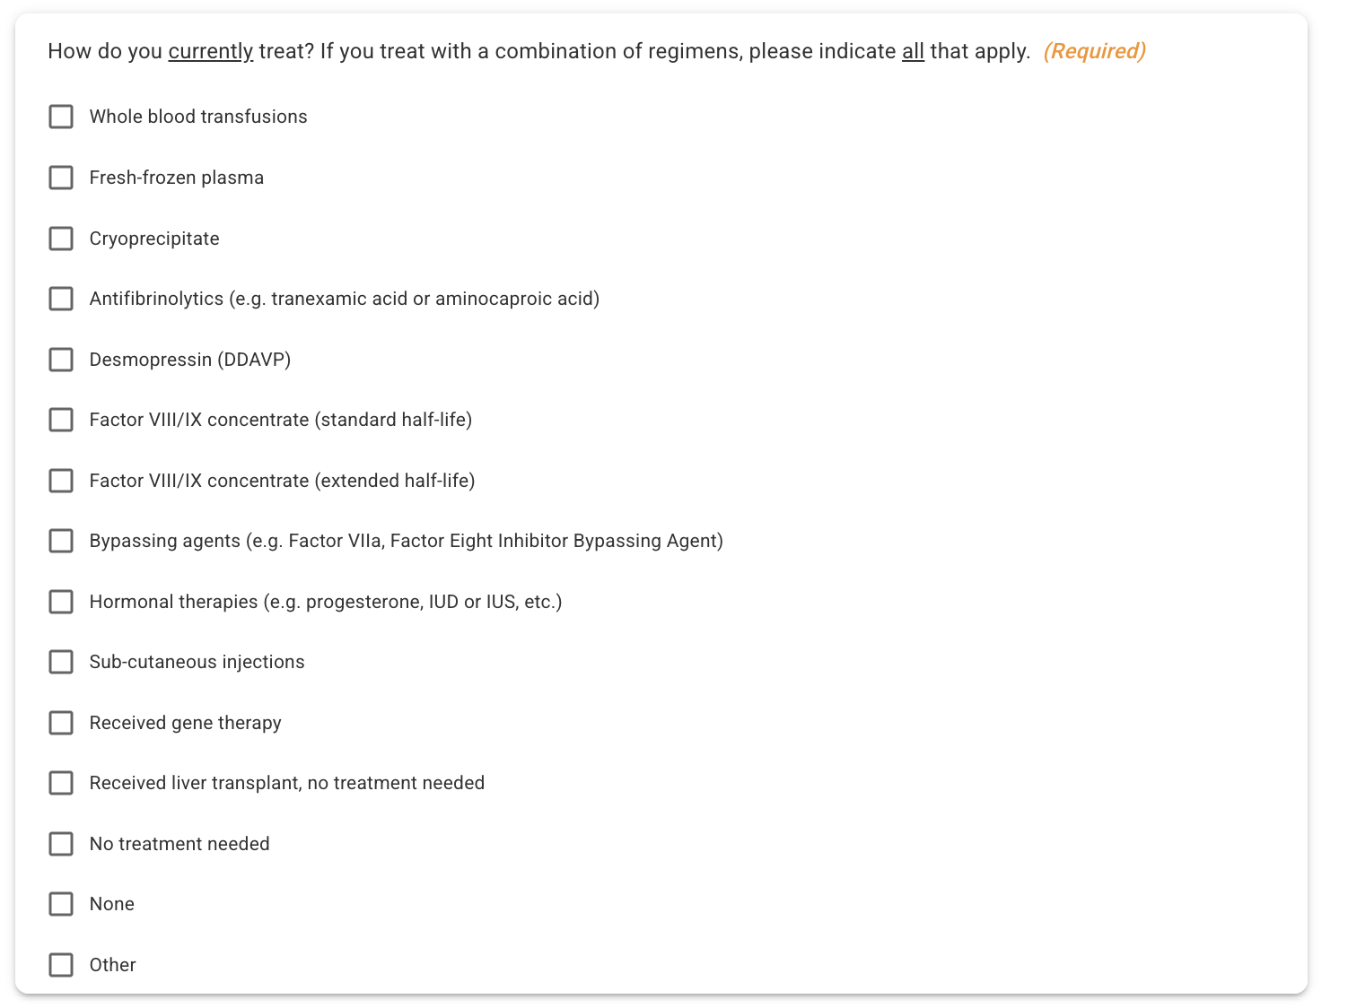

Slide 16
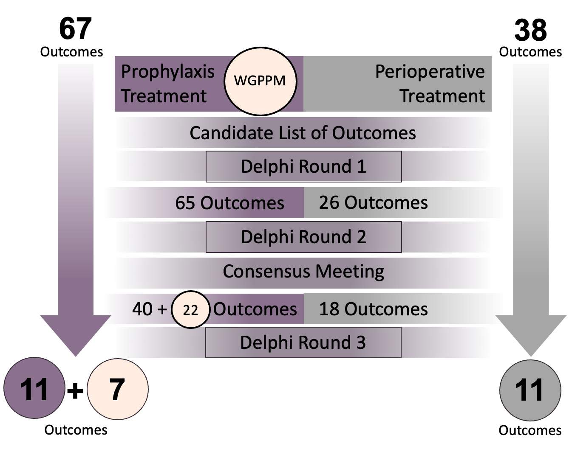
PROBE Enhancements – VWD Module

Slide 17
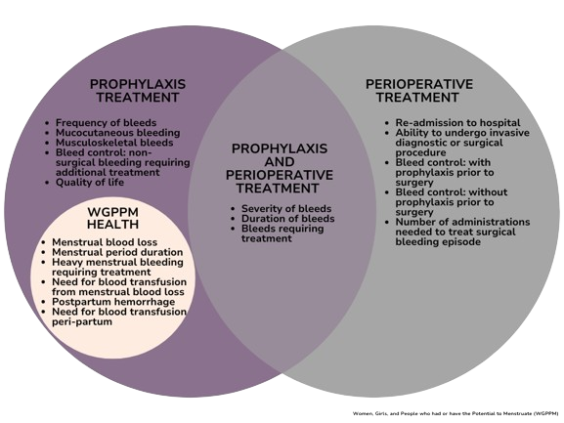

Slide 19
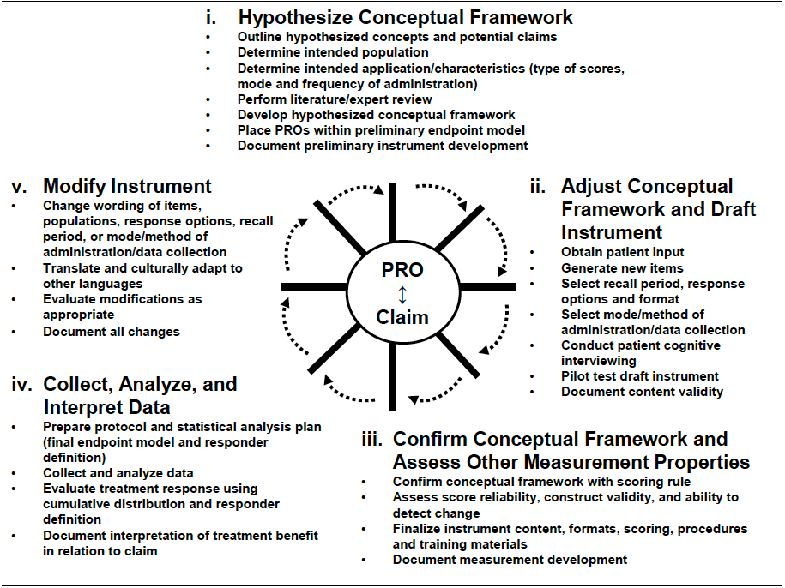
PROBE Enhancements – VWD Module
What do we know?
Interview People with VWD
Include new questions in studies
Test new questions

Slide 20
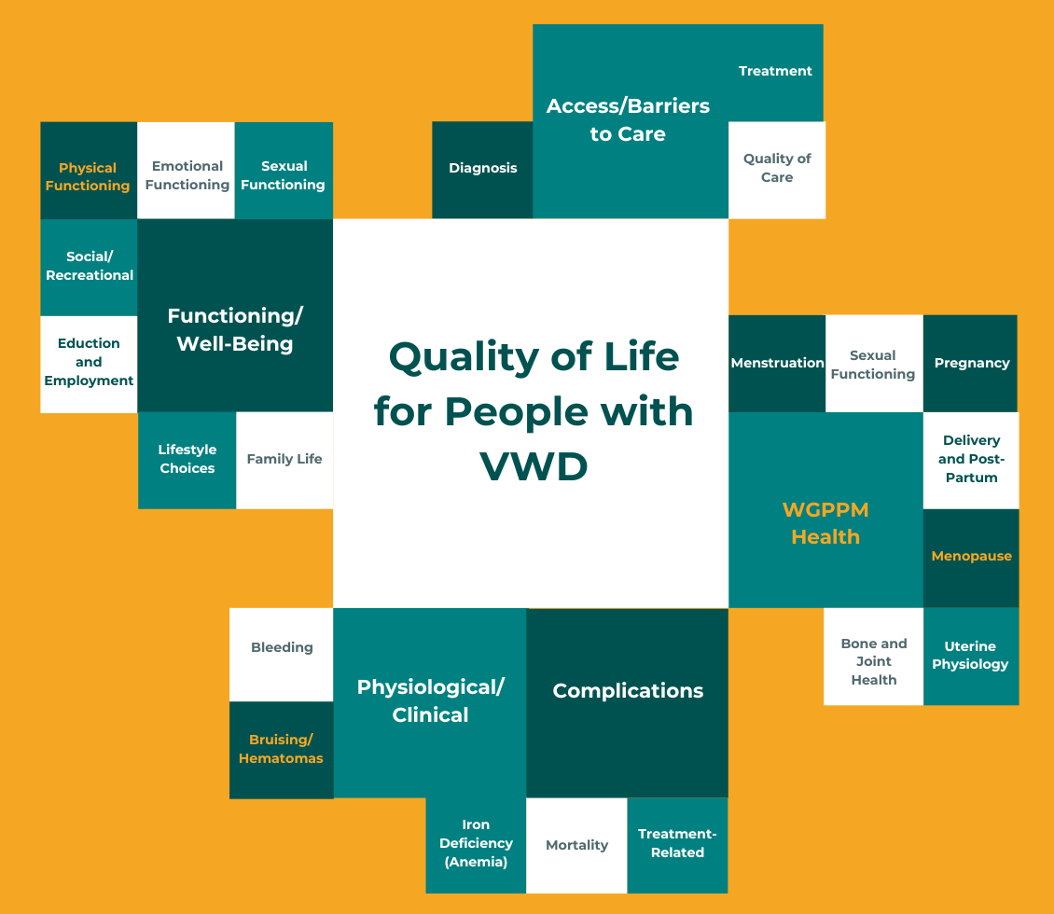
PROBE Enhancements – VWD Module

Slide 21
PROBE Enhancements – VWD Module
Emerging Themes
Participants
 | (n=25)
Age (years) Mean (Range) | 33.92 (16-69)
Sex Assigned at Birth (%)
Female | 17 (68)
Male | 8 (32)
Type of VWD (%)
Type 1 | 14 (56)
Type 2 | 6 (24)
Type 3 | 5 (20)
2. Women’s health is central, not peripheral – There are burdens in menstrual, reproductive, and sexual health.
3. Diagnostic delay is common – Symptoms are dismissed or normalized, even major bleeding events are not recognized as VWD.
1.Bleeding alone does not capture disease burden – PwVWD have to deal with unpredictability, prolonged healing, and uncertainty.
4. Emotional and cognitive burden are universal – There is worry and anxiety with treating, and the logistics of getting treatment impact day-to-day life.
5. Functional impact means unconscious adaptation - PwVWD often modify, avoid, and make trade-offs, suggesting the need to measure participation and restriction, not just impairment.
6. Access to care is reactive rather than proactive – There are geographic, political, and systemic barriers, and PwVWD are “bleeding their way to care.”

Slide 22
Global Research in Action
and
Section Highlights:
Elizabeth Clearfield
Overview of PROBE’s Global Footprint
Highlighting Abstracts from Participating Countries
Two Examples in More Detail
Senior Research Manager, Institute for Policy Advancement, Ltd.
EClearfield@ipaltd.com

Slide 23
Global Research in Action
Global implementation plus country-specific abstract and publication examples
Global footprint
Abstract / poster collage
105+
A few examples from the country-specific entries
Countries where PROBE has been implemented
BRAZIL
POLAND
NICARAGUA
15
PROBE: Brazil data
Changing community needs
Quality of life in hemophilia
Country-focused publications
WFH 2024
WFH 2022
WFH 2022
13
Countries represented in publications
KYRGYZSTAN
MEXICO
COLOMBIA
Quality of life using PROBE
Registry integration with PROBE
Severe hemophilia A study in children and adults
Countries visible as standalone items
Australia*, Brazil*, Canada, Colombia, Ireland, Kosova, Kyrgyzstan, Malta, Mexico, Nicaragua, Poland, Slovenia, and Vietnam
ISTH 2021
WFH 2022
EAHAD 2021
*Australia and Brazil used PROBE study in number of times for self-publications.
Visit the most recent poster at WFH 2026
KOSOVO
Patient-Reported Outcomes in Hemophilia in Kosovo
International collaborations
WFH 2026

Slide 24
Featured Abstracts
Brazil and Kyrgyzstan are both contain concrete, advocacy-ready findings
BRAZIL
KYRGYZSTAN
PROBE: Brazil data
Quality of life of patients in Kyrgyzstan using the PROBE tool
WFH 2024 poster abstract
ISTH 2021 oral presentation
679
58.25%
85%
37
18.9%
83.8%
questionnaire contributions
reported chronic pain
of chronic pain in target joints
participants
reported some prophylaxis
reported reduced range of motion
Key findings
Key findings
• The Brazil dataset included 321 people with hemophilia A, 49 with hemophilia B, 35 carriers, and 274 controls.
• Among people with hemophilia A or B and carriers, 168 were severe and 45 were moderate; about 65% treated at home.
• The abstract links pain burden to the need for better public policy and care improvement.
• Only 18.9% reported access to some prophylaxis, while 59.5% reported episodic treatment and 16.2% no treatment availability.
• 75.7% reported chronic pain, 70.3% impact on daily living, and 83.8% reduced joint range of motion.
• The conclusion explicitly points to prophylaxis as a route to better health for future generations.
Example combines scale, treatment pattern, and pain burden in one country-specific story.
Example shows access gaps and disability burden very clearly, with a strong improvement message.

Slide 25
Debut of the New PROBE Dashboard
and
Section Highlights:
Preview of the new PROBE Dashboard
Demo how to make data more accessible
Mark W. Skinner
President/CEO, Institute for Policy Advancement, Ltd.; President/CEO, Patient Outcomes Research Group Ltd.
mskinner@ipatld.com

Slide 26

Debut of the New PROBE Dashboard
and
Click on the picture to open YouTube Link

Slide 27
Updates from WAPPS and Calibra
and
Section Highlights:
New Developments in WAPPS and Calibra
Arun Keepanasseril
Director of Operations, Canadian Bleeding Disorder Registry; Assistant Clinical Professor (Adjunct)
Keeppaa@mcmaster.ca
Notes:
[Sources]
- Poster and free paper details supplied by user in conversation
- Slide wording based on user-provided poster information and instructions
[/Sources]

Slide 28
Discussion and Q&A
and
Mark W. Skinner
Arun Keepanasseril
Elizabeth Clearfield
President/CEO, Institute for Policy Advancement, Ltd.; President/CEO, Patient Outcomes Research Group Ltd.
Director of Operations, Canadian Bleeding Disorder Registry; Assistant Clinical Professor (Adjunct)
Keeppaa@mcmaster.ca
Senior Research Manager, Institute for Policy Advancement, Ltd.
EClearfield@ipaltd.com
Notes:
[Sources]
- Poster and free paper details supplied by user in conversation
- Slide wording based on user-provided poster information and instructions
[/Sources]

Slide 29
Posters, Free Paper, and Exhibition Hall
and
Where to find us during WFH 2026 Kuala Lumpur
Visit our table
Posters available for view
Oral presentation
PROBE and WAPPS-Hemo have a table in the Exhibition Hall where attendees can stop by, meet the team, and ask questions.
Poster PP-322
Development of a refined data dashboard for PROBE
Adapting the Patient Reported Outcomes Burdens and Experiences (PROBE) Study to Measure Quality of Life in People with von Willebrand Disease (VWD)
Session title
Free Paper Session: Capacity Building, Care Models, and Patient Outcomes
Patient-Reported Outcomes in Hemophilia in Kosovo: Results from the PROBE Questionnaire
Poster PP-316
Exhibition Hall
Look for the combined PROBE and WAPPS-Hemo branding.
Session date
21 April 2026
Advancing Global Data Collection for Women with Bleeding Disorders: Early Insights from the PROBE WBD Module
Session time
Poster
PP-399
17:00–18:00 MYT
Questions • Networking • Live conversation
Join us in the exhibition hall and during the free paper session.
Notes:
[Sources]
- Poster and free paper details supplied by user in conversation
- Slide wording based on user-provided poster information and instructions
[/Sources]

Slide 30

Thank You
and
Contact us
For questions about the meeting, PROBE, or WAPPS-related collaboration, please connect with us.
Thank you for your interest in patient-centered outcomes research.
We look forward to seeing you again
Elizabeth Clearfield
Arun Keepanasseril
Senior Research Manager
Director of Operations
EClearfield@ipaltd.com
Keeppaa@mcmaster.ca
Alexandra (Sasha) Kucher
Website
Senior Research Data Manager
PROBEstudy.org
WAPPS-Hemo.org
AKucher@probestudy.org
Notes:
[Sources]
- Contact names and emails from user-provided DOCX: /mnt/data/PROBE Breakfast Meeting Agenda Refined.docx
- Website requested by user
[/Sources]

